Slide 1
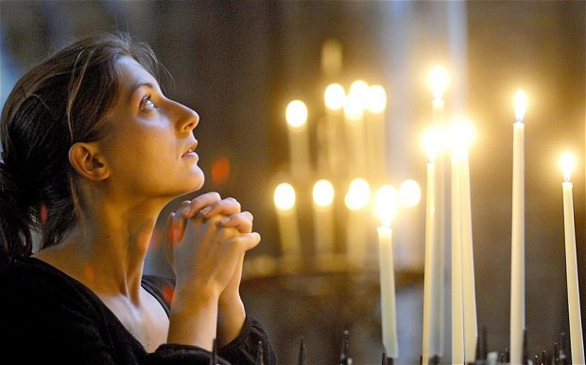

Slide 3
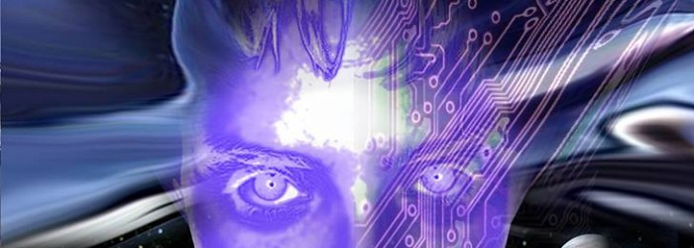

Slide 5
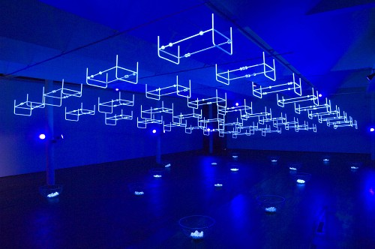

Slide 8
What is a “Worldview”?

Slide 9
A worldview is the set of beliefs about fundamental aspects of reality that ground and influence all one's perceiving, thinking, knowing, and doing.
—Dr. Ken Funk II, Oregon State Univ.

Slide 10
Whence Worldview?
Family
Community
Education
Language
Culture
Religion
Emotionally Evocative Events

Slide 11
Elements of Worldview
Epistemology
Metaphysics
Cosmology
Teleology
Theology
Anthropology
Axiology

Slide 12
Epistemology
Beliefs about the nature and sources of knowledge.
Is knowledge merely a state of the brain?
Manifestation of a cosmic mind?
Does it only come from sense experience?
Is there knowledge from beyond the senses?
Is there anything one can know for certain?

Slide 13
Metaphysics
What is the ultimate nature of reality?
Is everything just matter & energy?
Truth: Correspondence? Coherence? Pragmatic?
Is reality discovered empirically? Otherwise?

Slide 14
Cosmology
Origin of the universe, life, and humanity.
Is the universe a chance event? Created?
Is the universe orderly and predictable?
Did life originate by purely natural causes?
Did humanity originate by chance?

Slide 15
Teleology
The big question about purpose of the cosmos.
Is there any reason or purpose or end for the cosmos?
If so, what purpose is it?
If so, whose purpose is it?

Slide 16
Theology
The existence and nature of a god or gods.
Is there a god or any number of gods?
If so, what is the nature of the god(s)?
What is the relationship of the god(s) to the universe?
What is the relationship of the god(s) to humanity?

Slide 17
Anthropology
The nature of humanity.
Are humans basically good? Evil?
Do humans have free will?
Are humans merely advanced animals?
Is there such a thing as “human nature”?

Slide 18
Axiology
The nature and study of values.
What is the highest good? Peace? Self-actualization? Pleasure? Knowledge?
Are there intrinsically valuable things?
Who determines value?
Are there morals? Are they objective? Subjective? Discovered? Created?

Slide 19
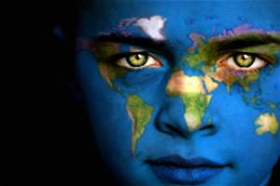
Should we care what worldview another holds?

Slide 20
Can another’s worldview be changed?

Slide 21
Can any worldview be shown to be superior?

Slide 22
Worldview Tests
Ken Samples’ 9 tests for truth
COHERENCE: is the worldview logically consistent?
PARSIMONY [“Balance Test”]: is it as complex and simple as necessary?
EXPLANATORY POWER & SCOPE: does it explain a broad scope of phenomena and do so in detail?

Slide 23
Worldview Tests
Ken Samples’ 9 tests for truth
CORRESPONDENCE: does the worldview correspond with the way the world really is in fact and in human experience?
VERIFICATION: can its claims be verified or falsified?
PRAGMATICS: is it socially and individually workable in real life?

Slide 24
Worldview Tests
Ken Samples’ 9 tests for truth
EXISTENTIAL SATISFACTION: does the worldview answer humanity’s desire for meaning, purpose, and significance?
CUMULATIVE RELIABILITY: do multiple lines of evidence accumulate to justify the worldview?
COMPETITIVE COMPETENCE: is it able to compete with others and adapt to new discoveries?

Slide 25
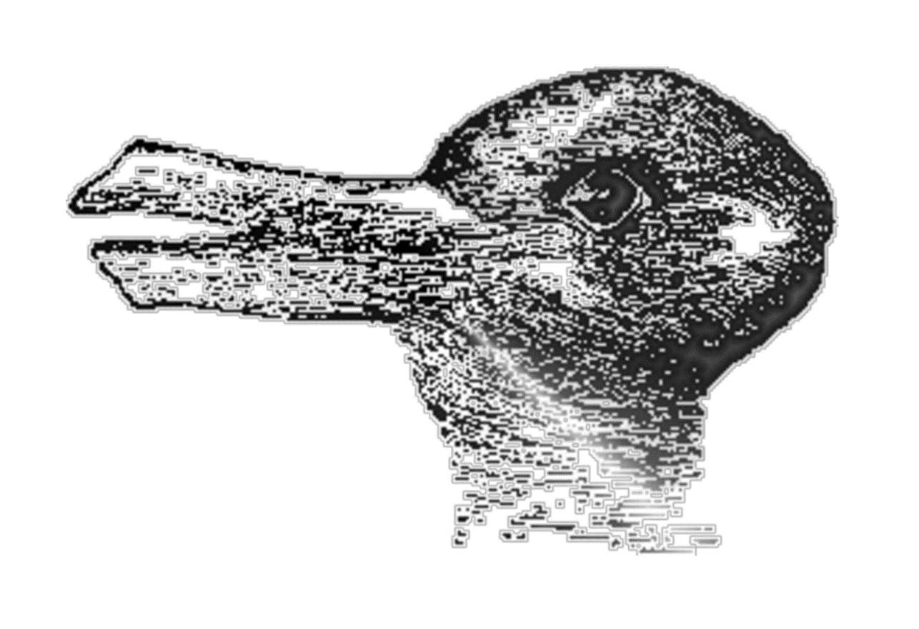
Worldviews can lead to different understandings of the same phenomena

Slide 27
All that we value and think
begins and ends
in our worldview

