Slide 1
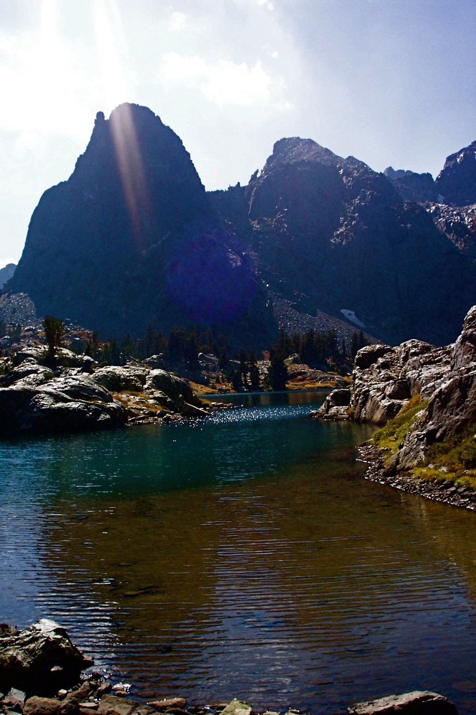
Solar Luminosity
100%
90%
80%
0 1 2 3 4 5 6
Sun’s age (billions of years)
Hugh Ross
Notes:
Advanced life can tolerate only a tiny change in solar luminosity.

Slide 4
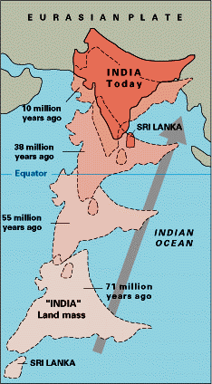

Slide 6
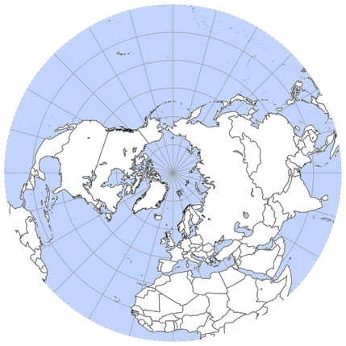

Slide 7
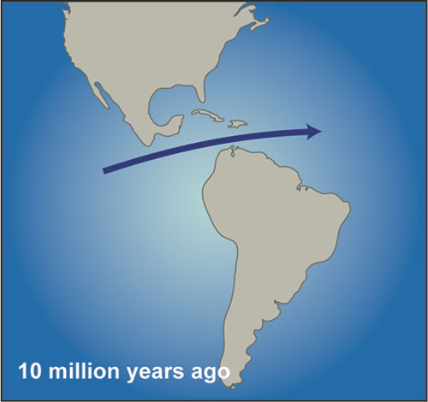
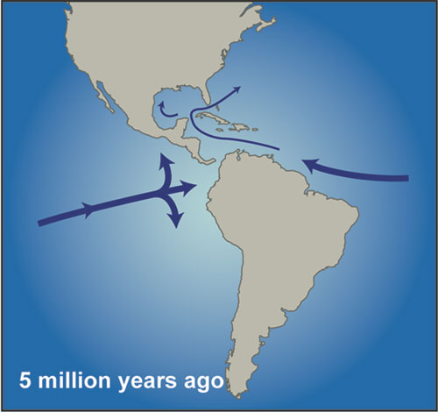
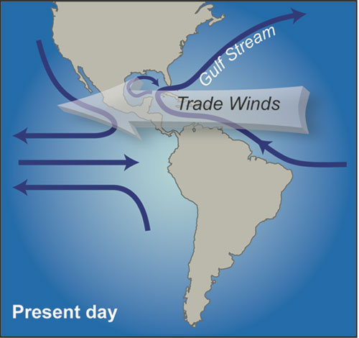
Rise of the Isthmus of Panama and the Closing of the Central American Seaway

Slide 9
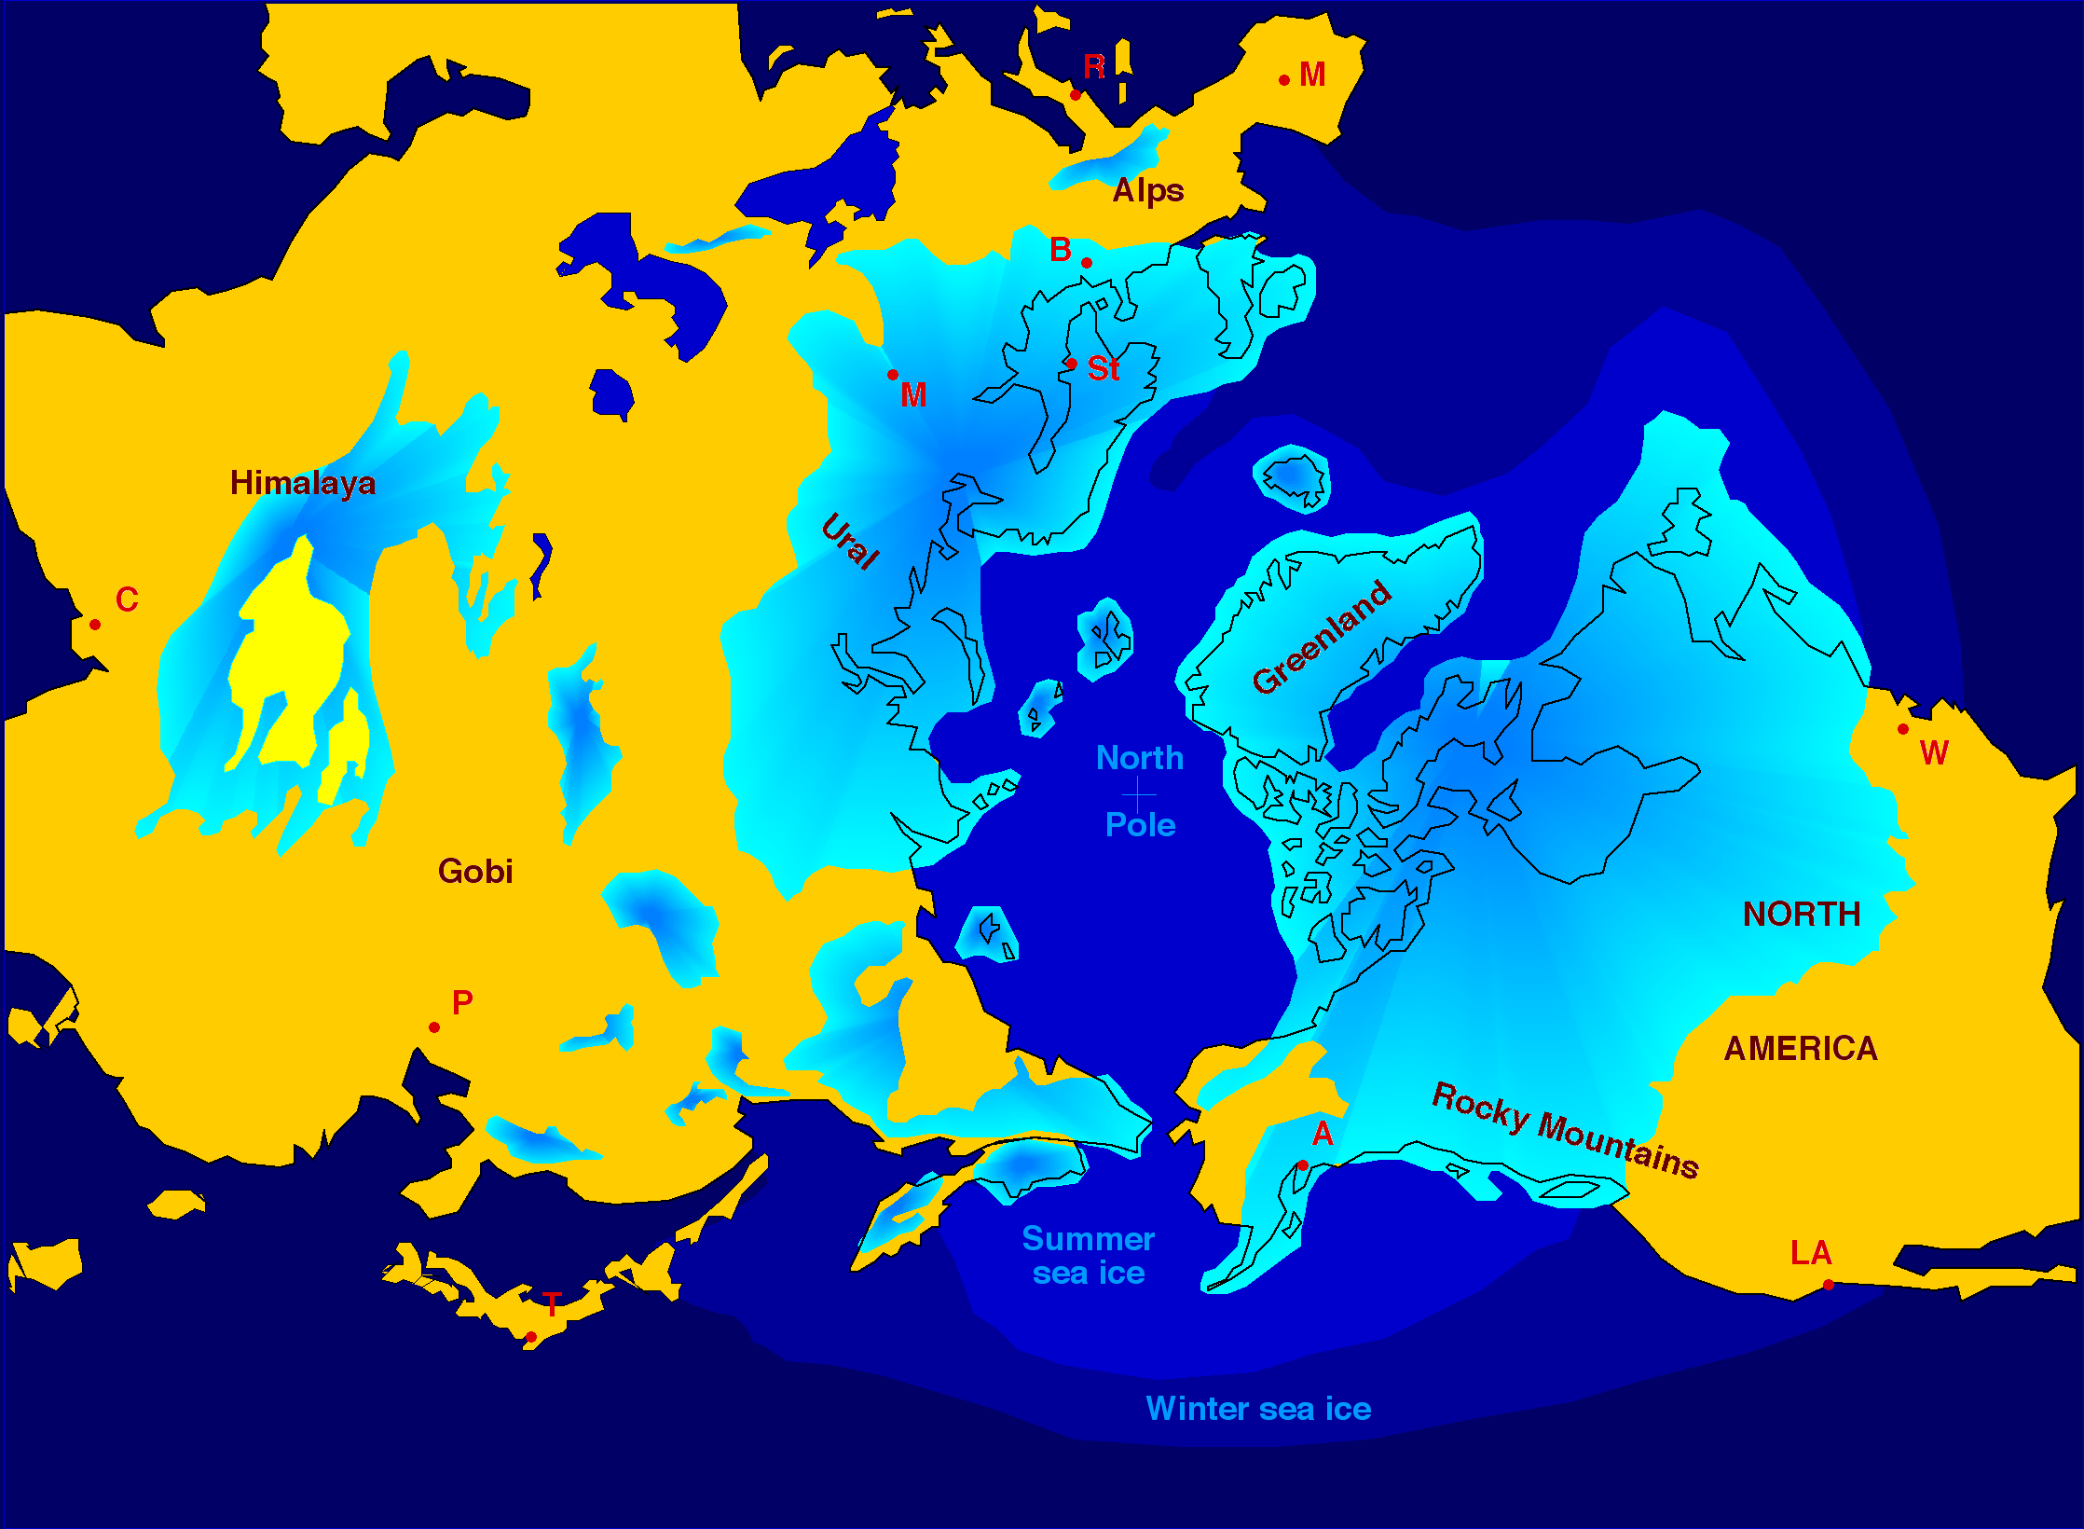

Slide 10
Temperatures Last 400 K Years
K Years BP

Slide 11
