Slide 1
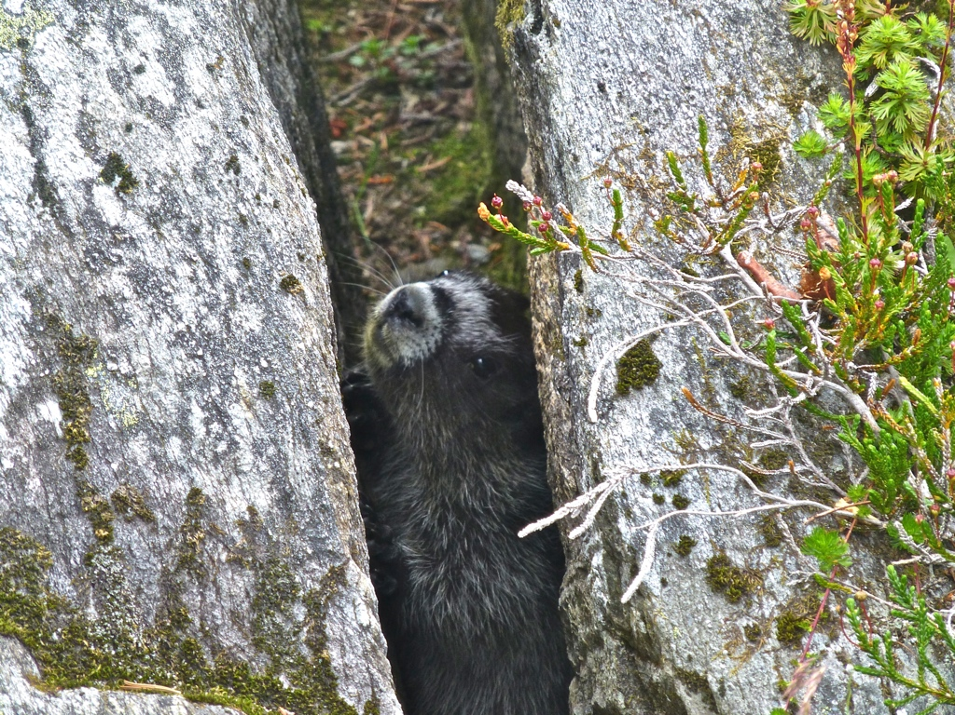

Slide 2
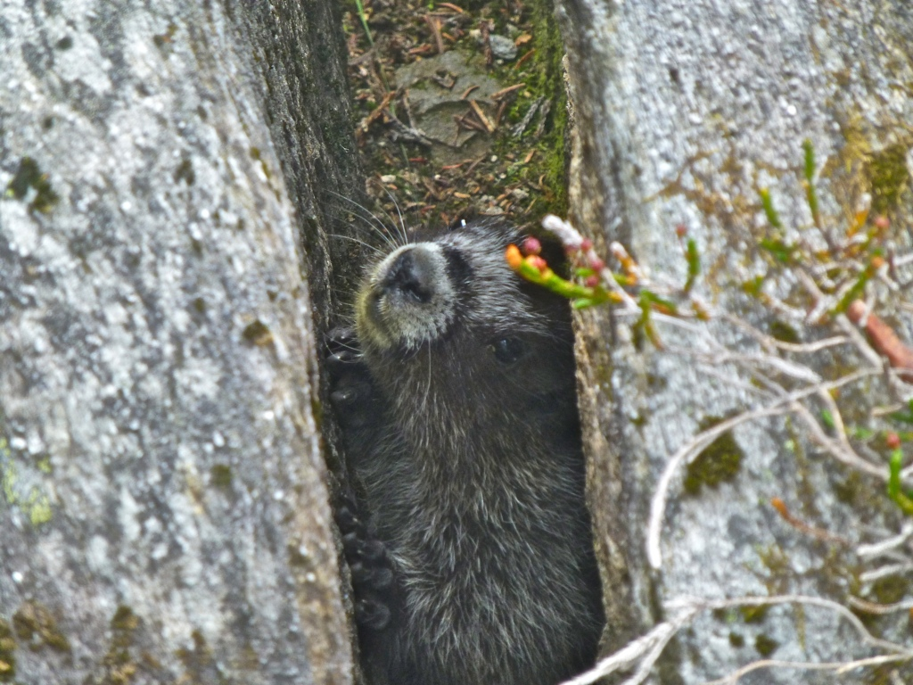

Slide 3
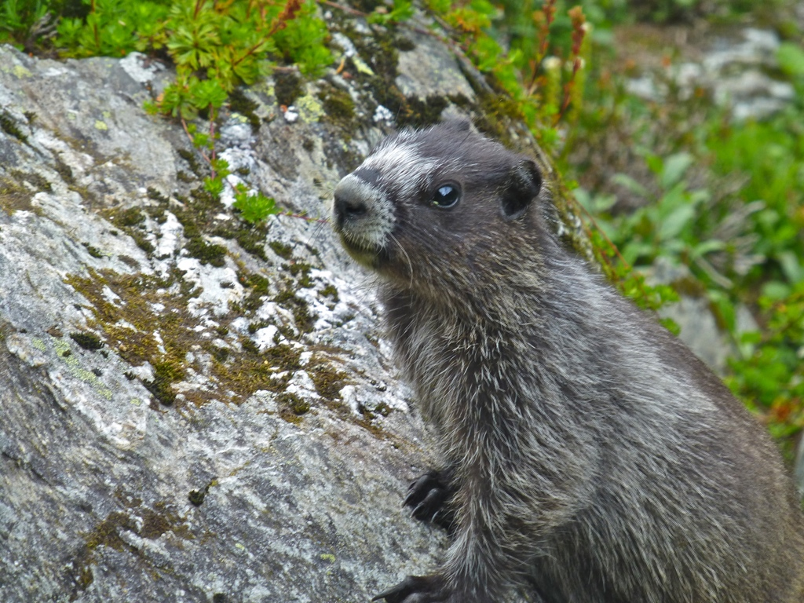

Slide 4
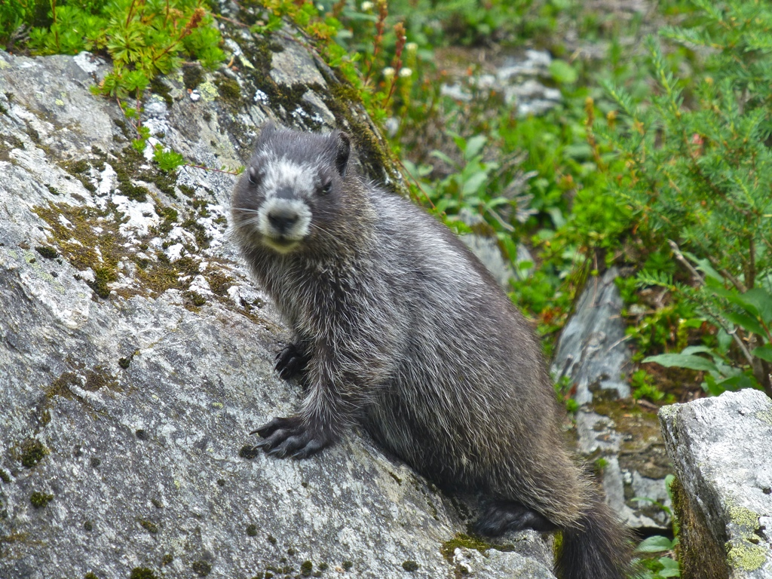

Slide 5
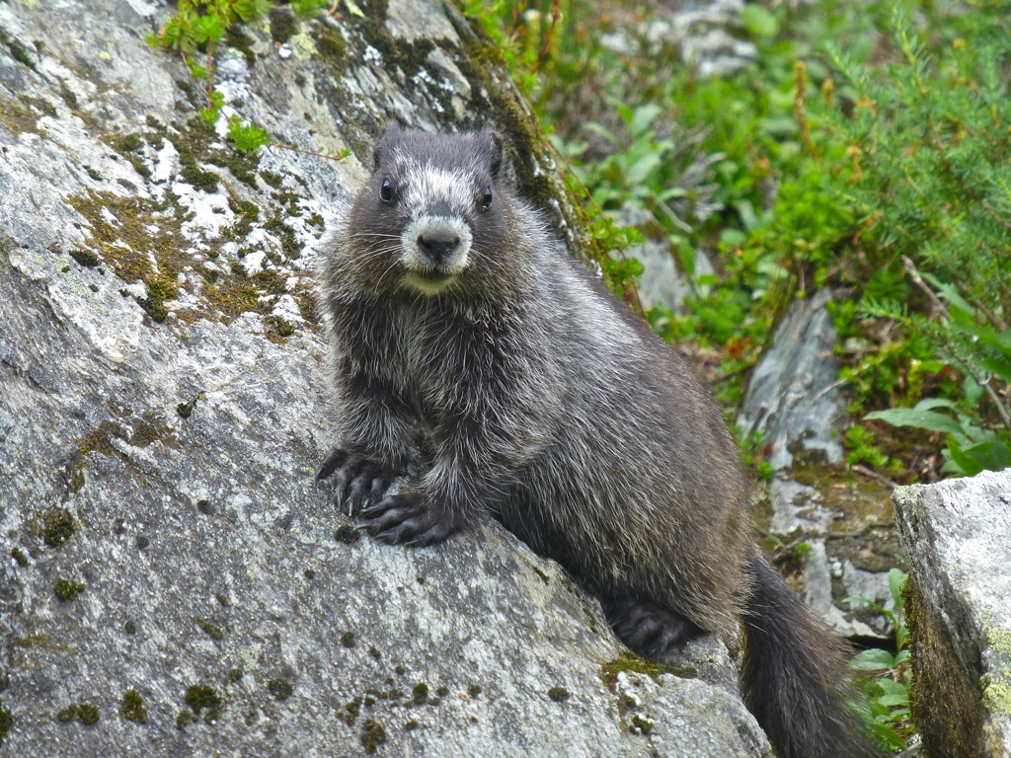

Slide 6
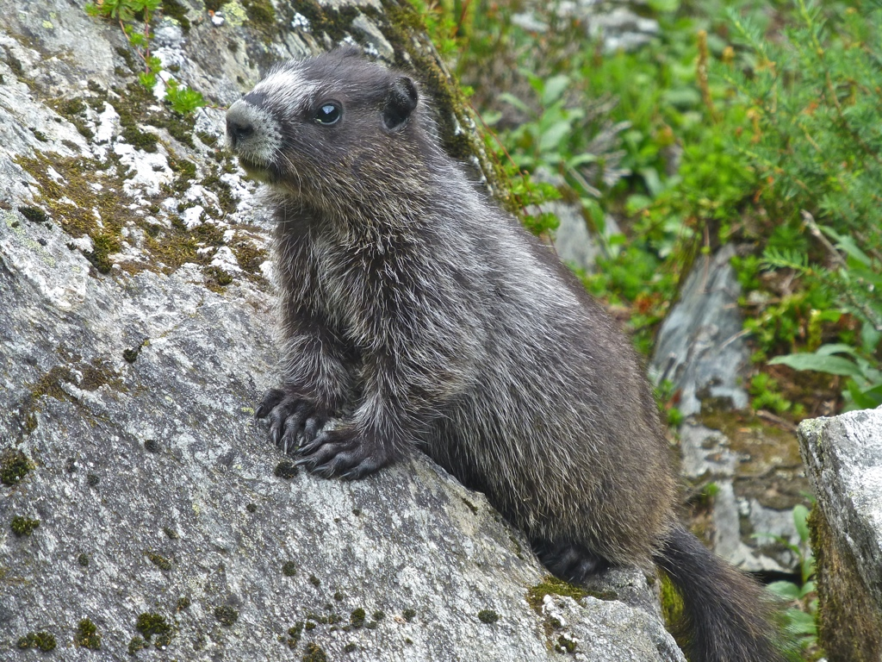

Slide 7
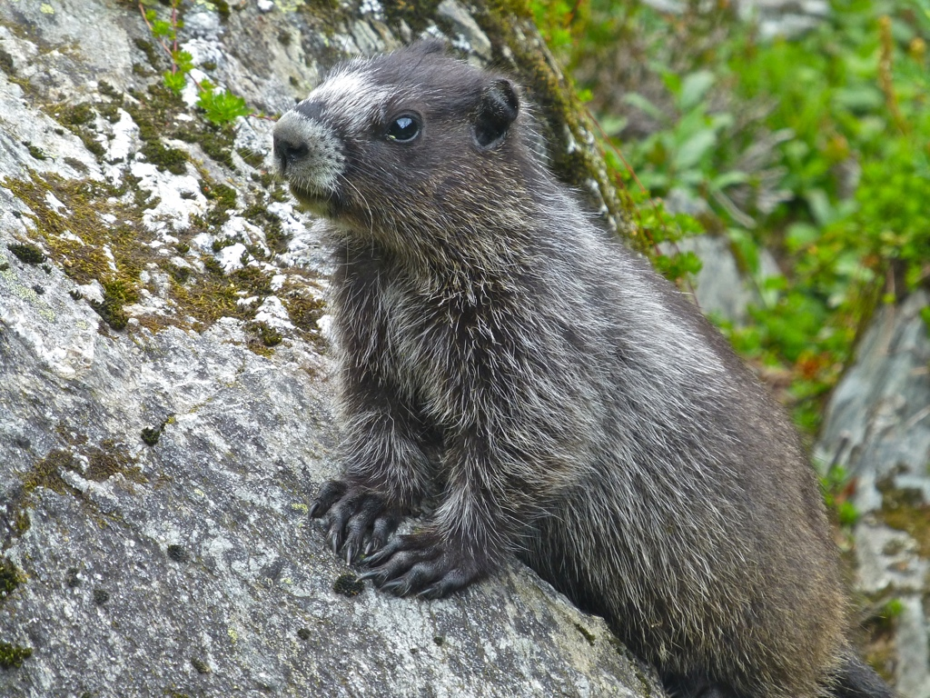

Slide 8
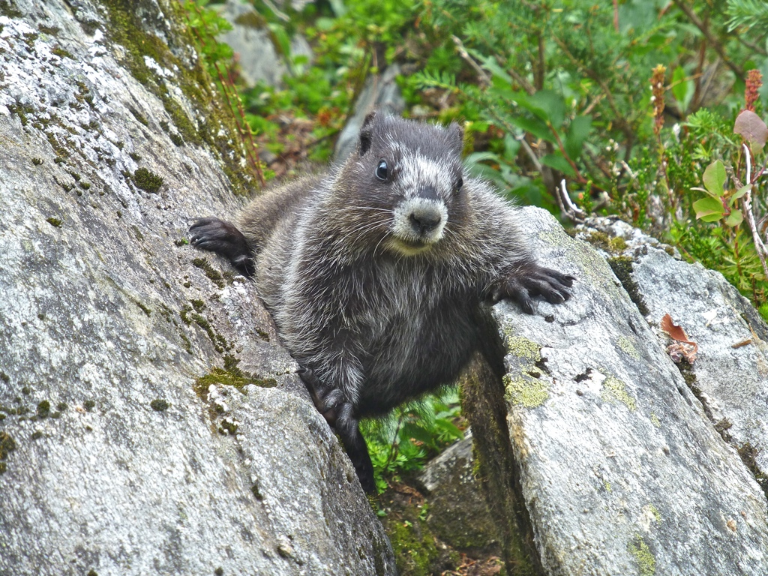

Slide 9
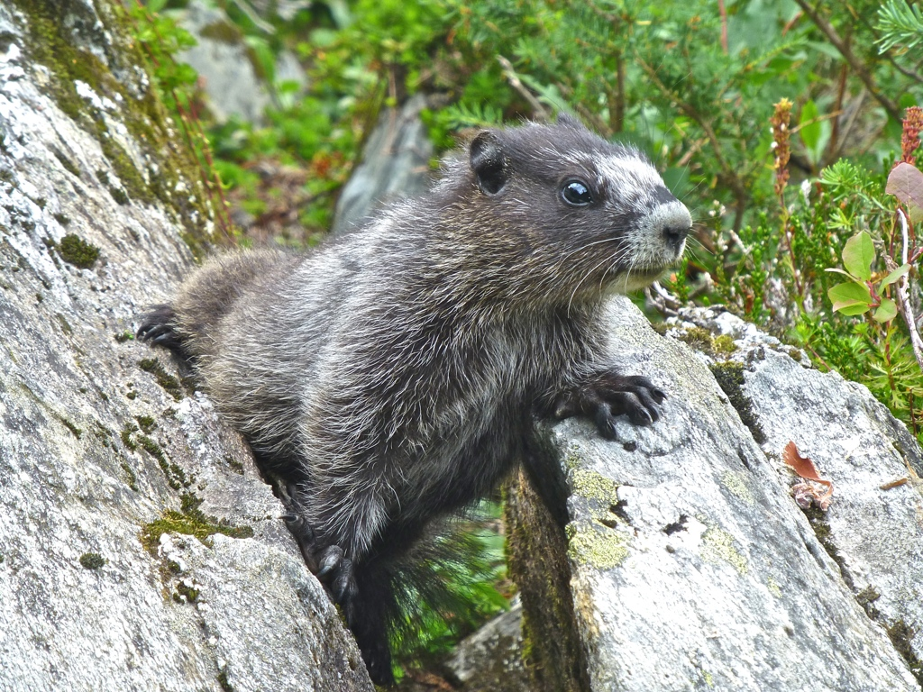

Slide 10
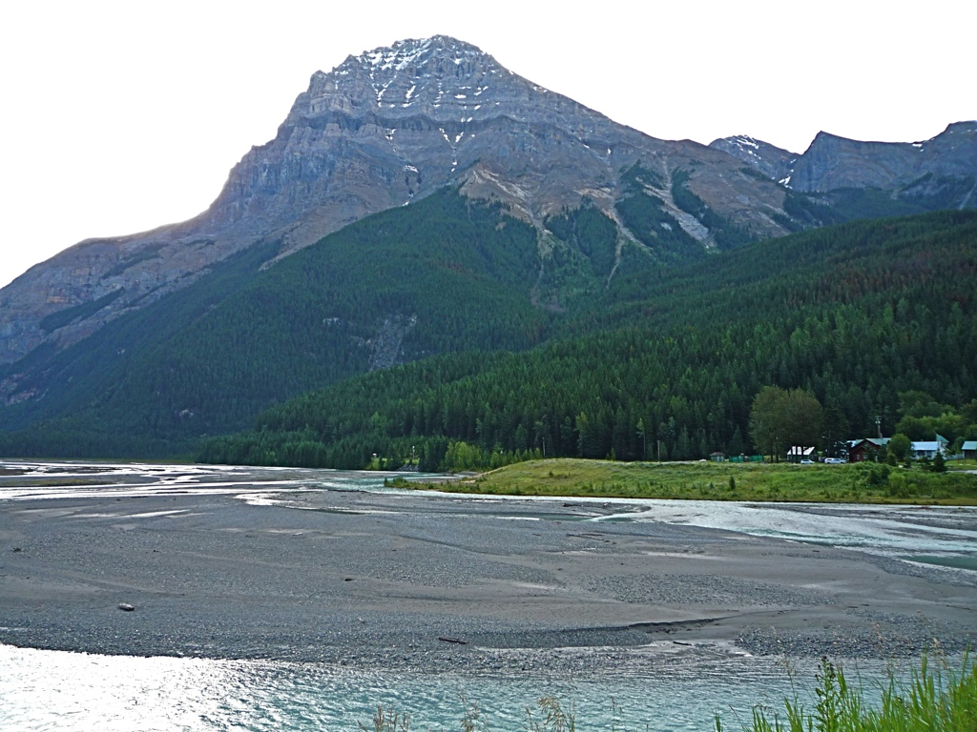

Slide 11
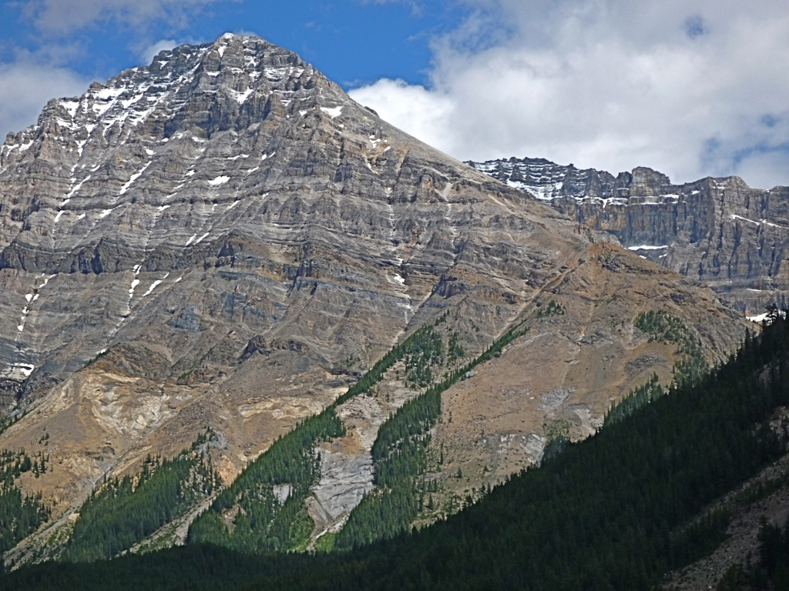

Slide 12
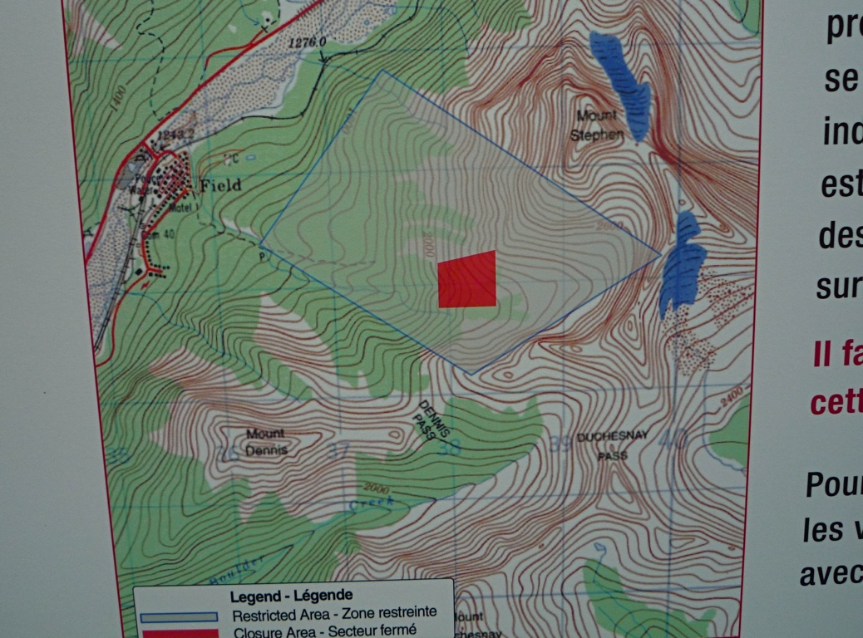

Slide 13
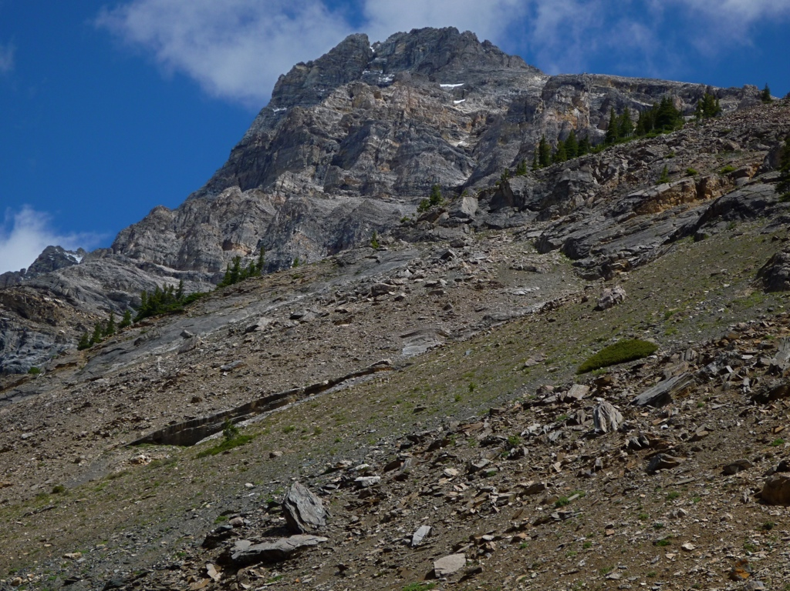

Slide 14
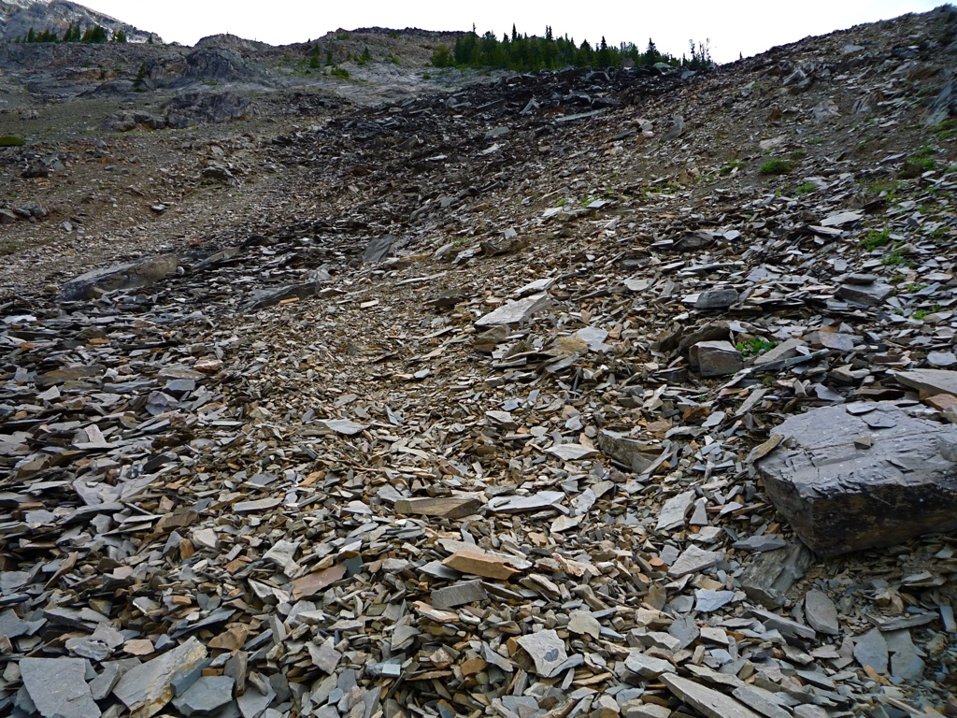

Slide 15
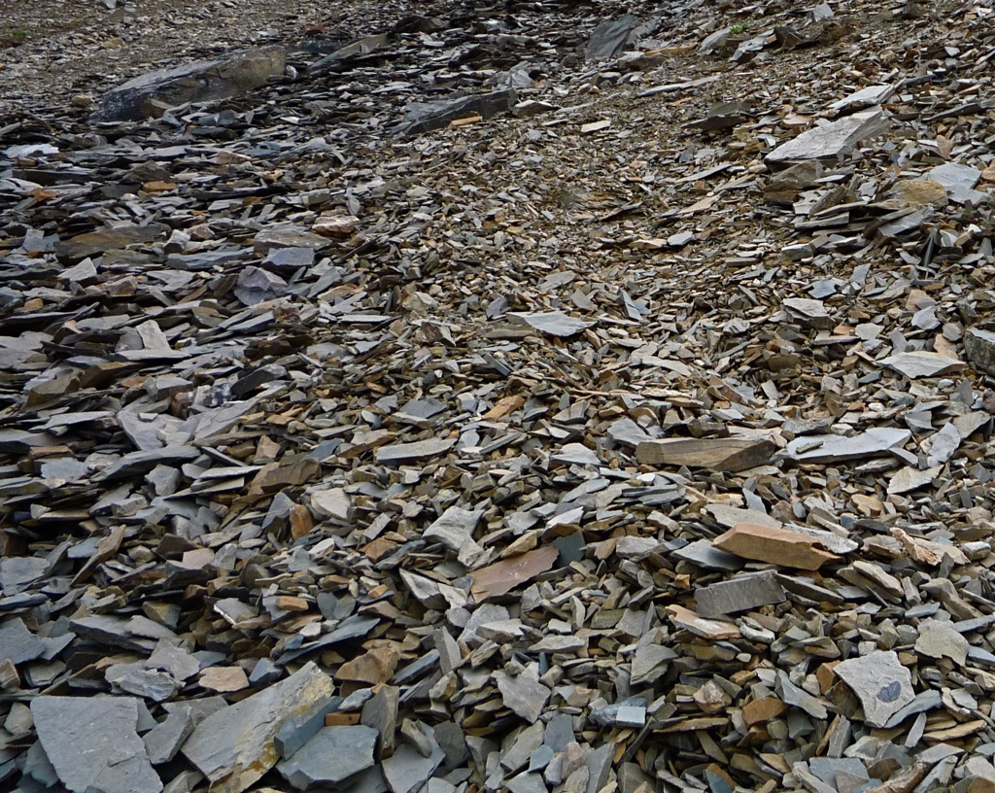

Slide 16
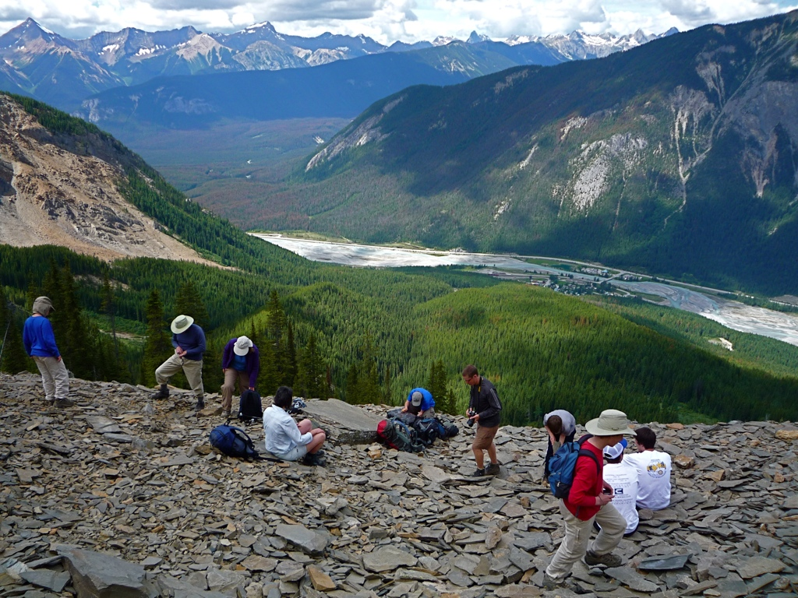

Slide 17
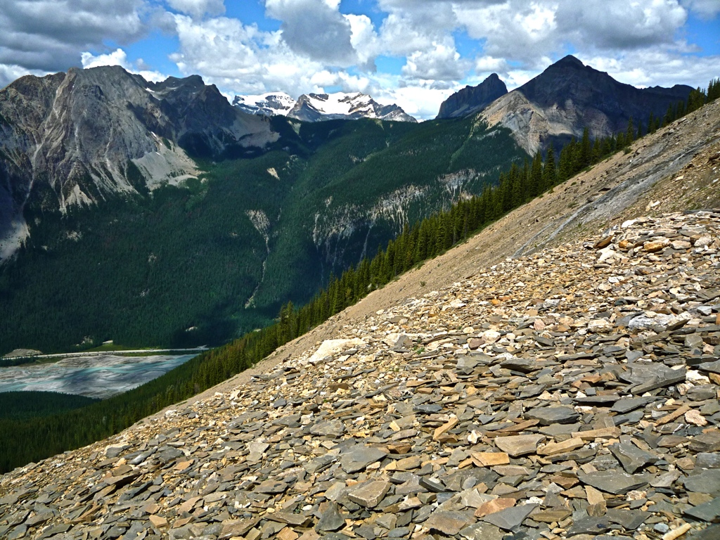

Slide 18
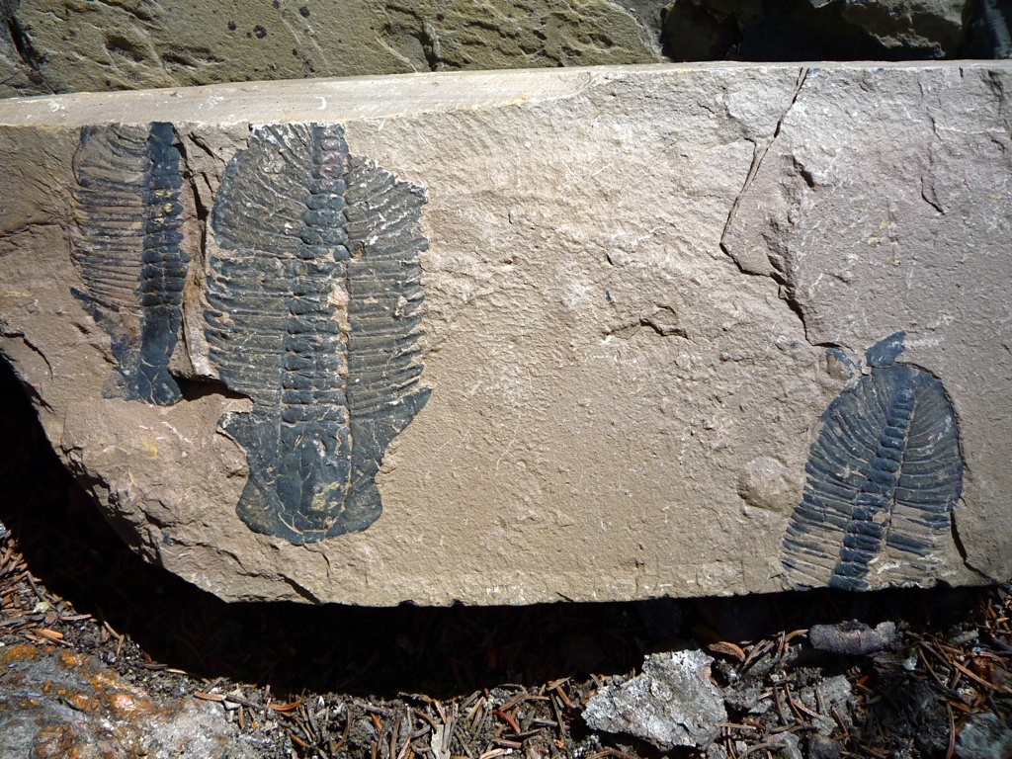

Slide 19
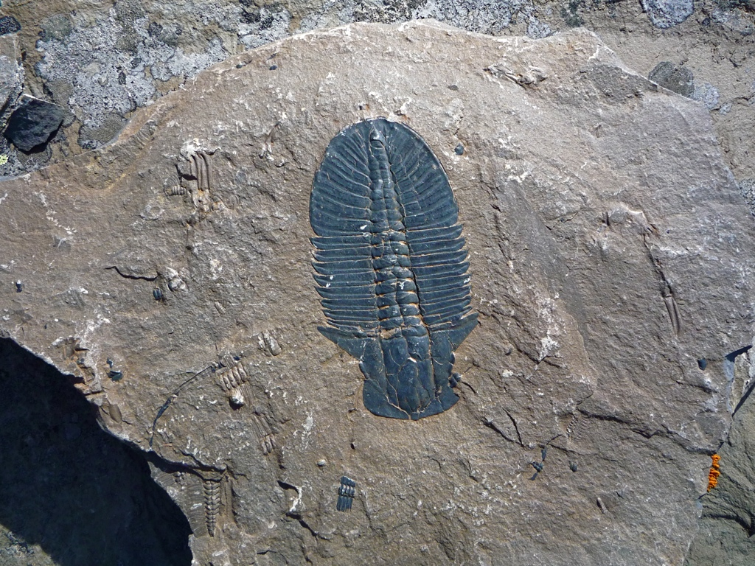

Slide 20
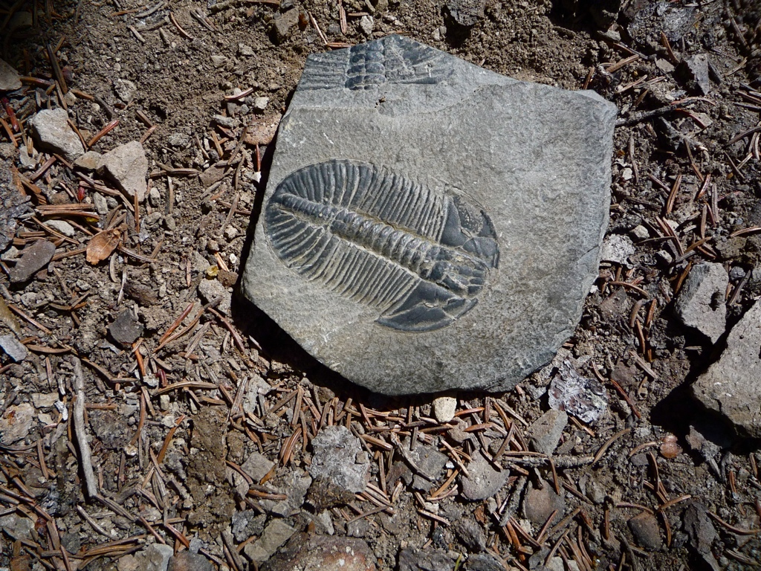

Slide 21
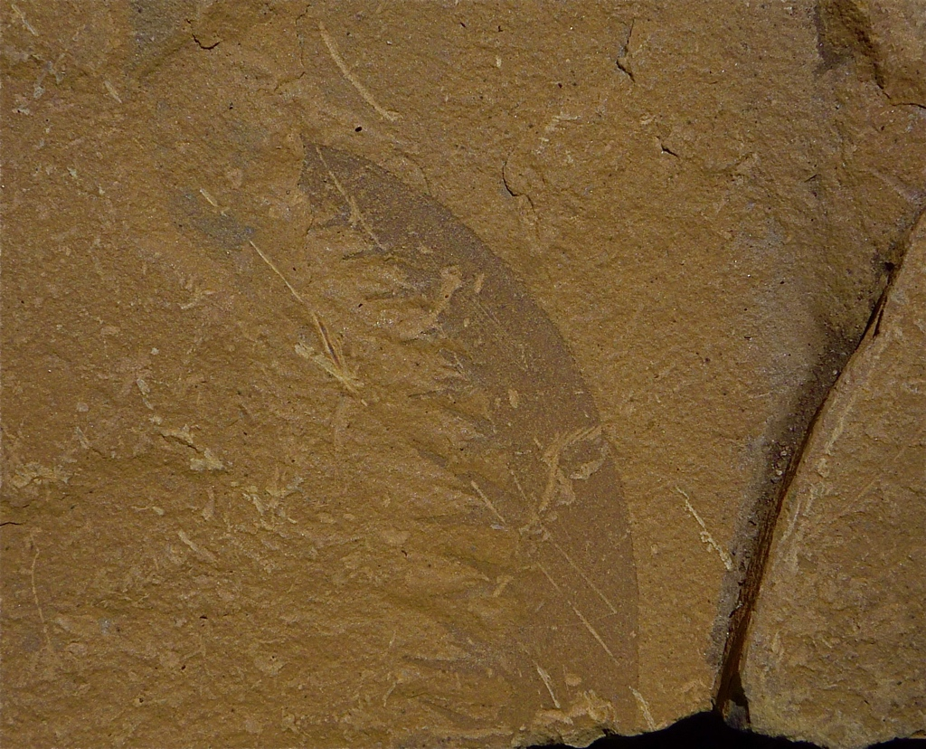

Slide 22
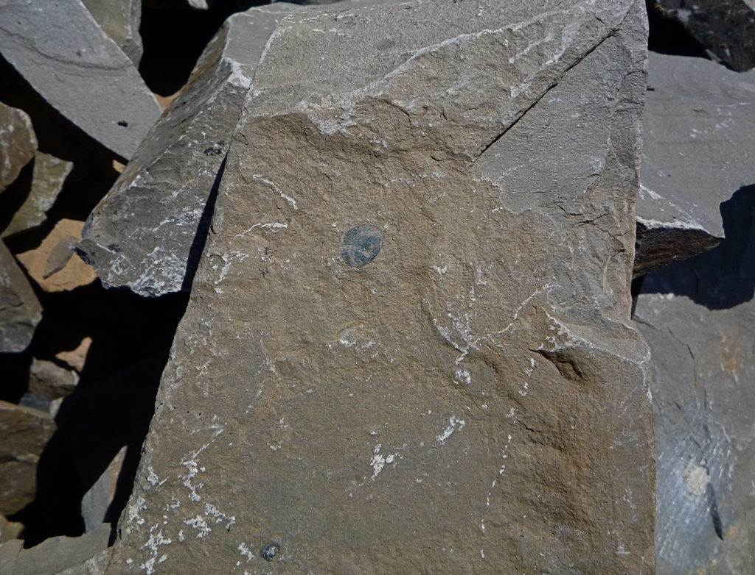

Slide 23
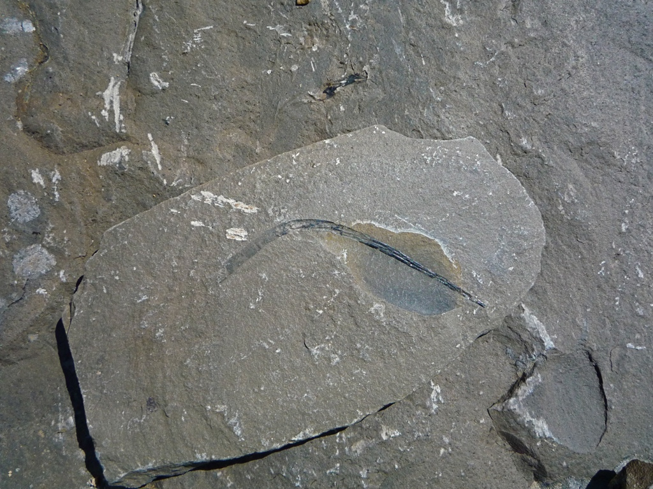

Slide 24
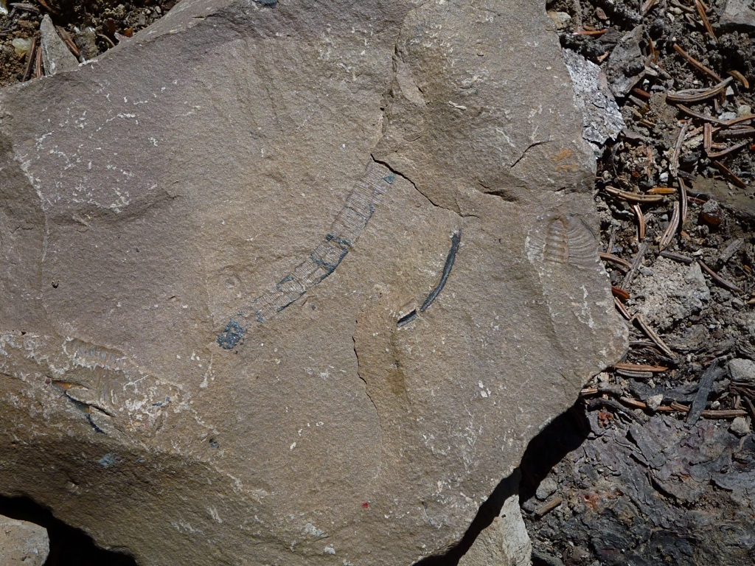

Slide 25
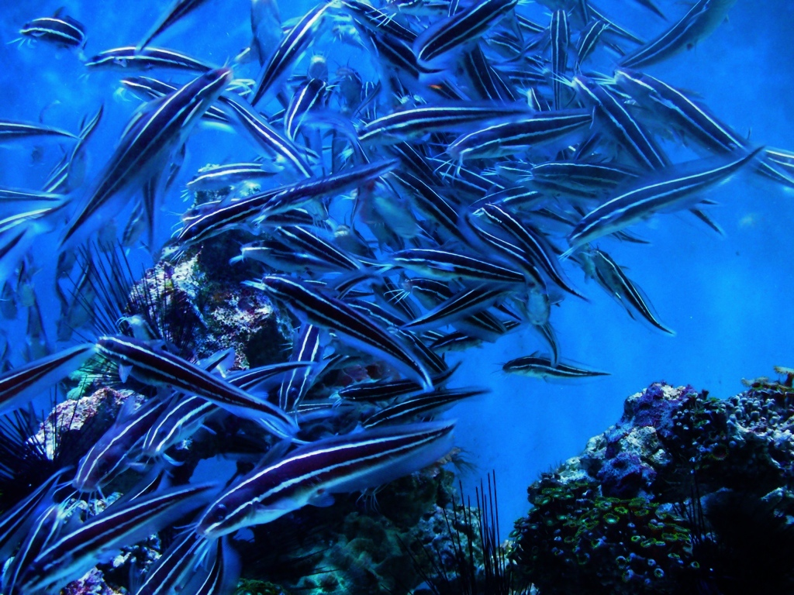
God packs Earth with as much life as possible for as long as possible.

Slide 26
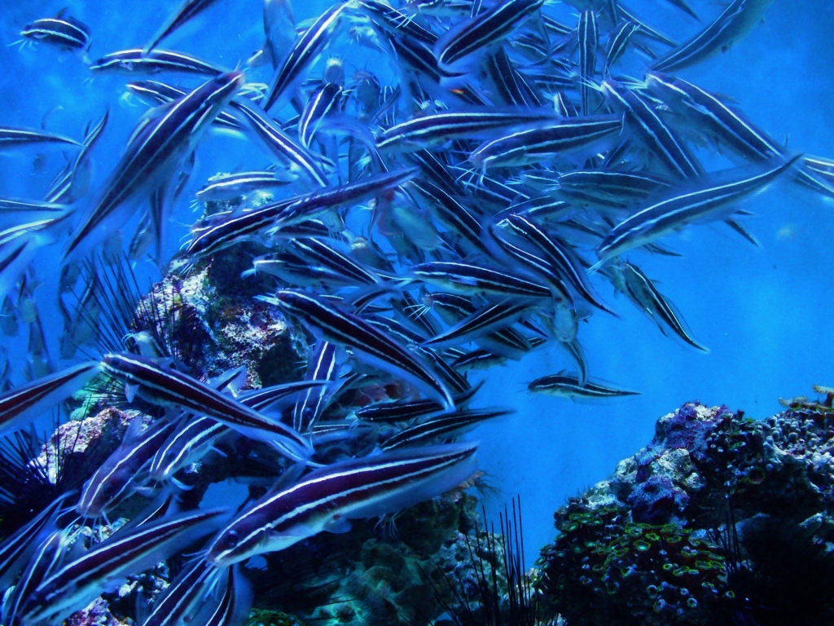
How many are your works, O Lord! In wisdom you made them all; the earth is full of your creatures.
Psalm 104:24

Slide 27
There is the sea, vast and spacious, teeming with creatures beyond number—living things both large and small.
Psalm 104:24

Slide 28
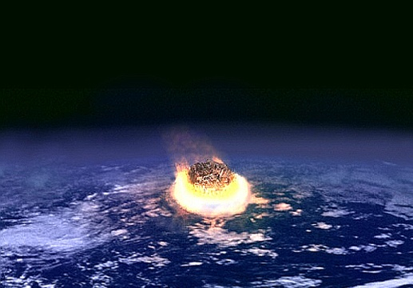
God uses cycles of mass extinctions and speciations.
NASA

Slide 29
When you hide your face, they are terrified; when you take away their breath, they die and return to the dust.
Psalm 104:29
NASA

Slide 30
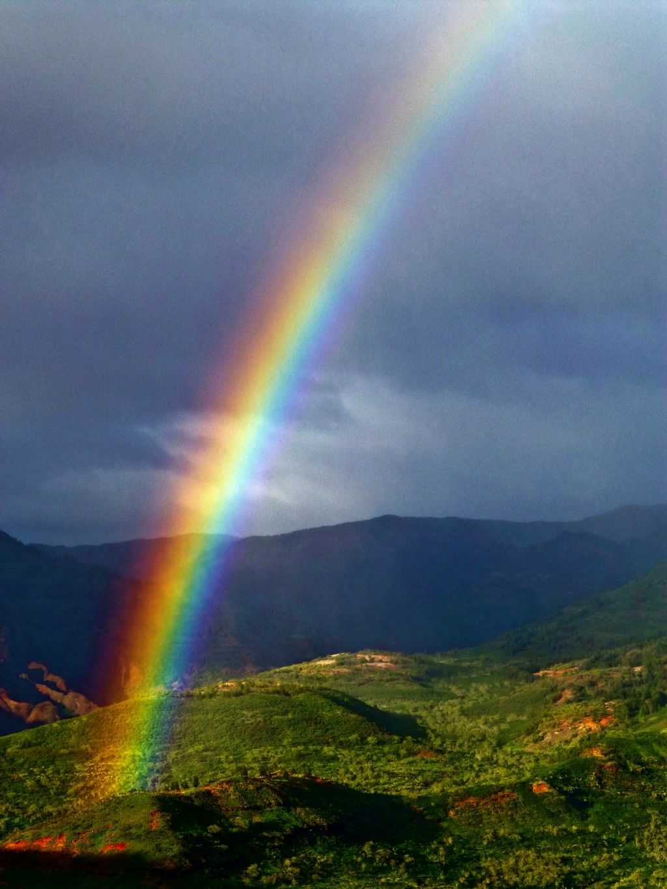
When you send your spirit, they are created, and you renew the face of the earth.
Psalm 104:30
Hugh Ross

Slide 31
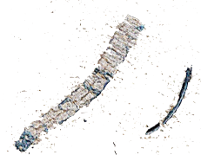
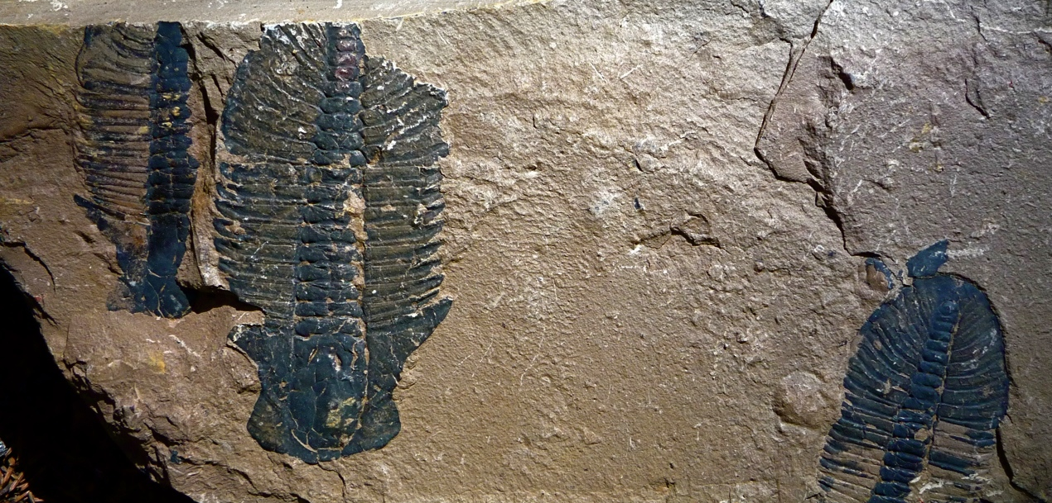
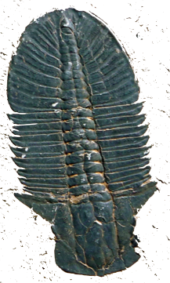
Cambrian Explosion Timing
Hugh Ross

Slide 32
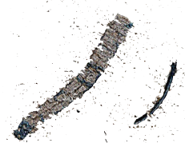
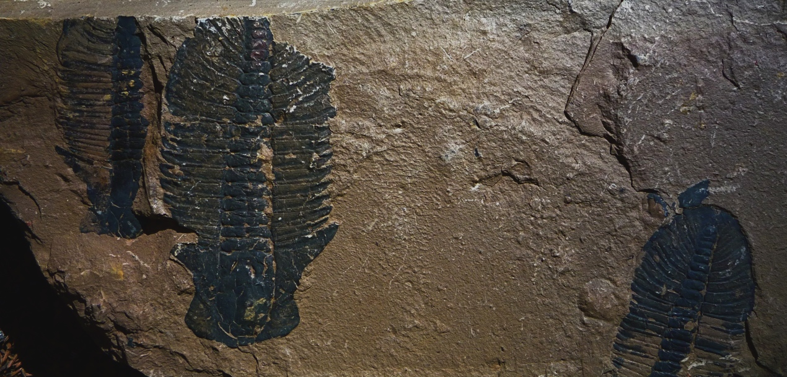
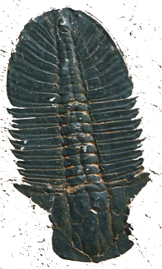
Cambrian Explosion Timing
just after the last snowball event
just after last spiral arm crossing
just after oxygen level rises above 8-10%
just after transparent skies appear for the first time
Hugh Ross

Slide 33
Cambrian Explosion Timing
just after continental coverage of Earth’s surface attains 27%
just after continental soils mature enough to sustain advanced plants
just after the mass extinction of Avalon explosion animals
Hugh Ross
Notes:
Avalon explosion occurs immediately after atmospheric oxygen level reaches about 8%.

Slide 34
Cambrian Explosion Timing
540 million years before mineable fossil fuel peaks
540 million years before limestone deposits peaks
Hugh Ross
Notes:
Avalon explosion occurs immediately after atmospheric oxygen level reaches about 8%.

Slide 35
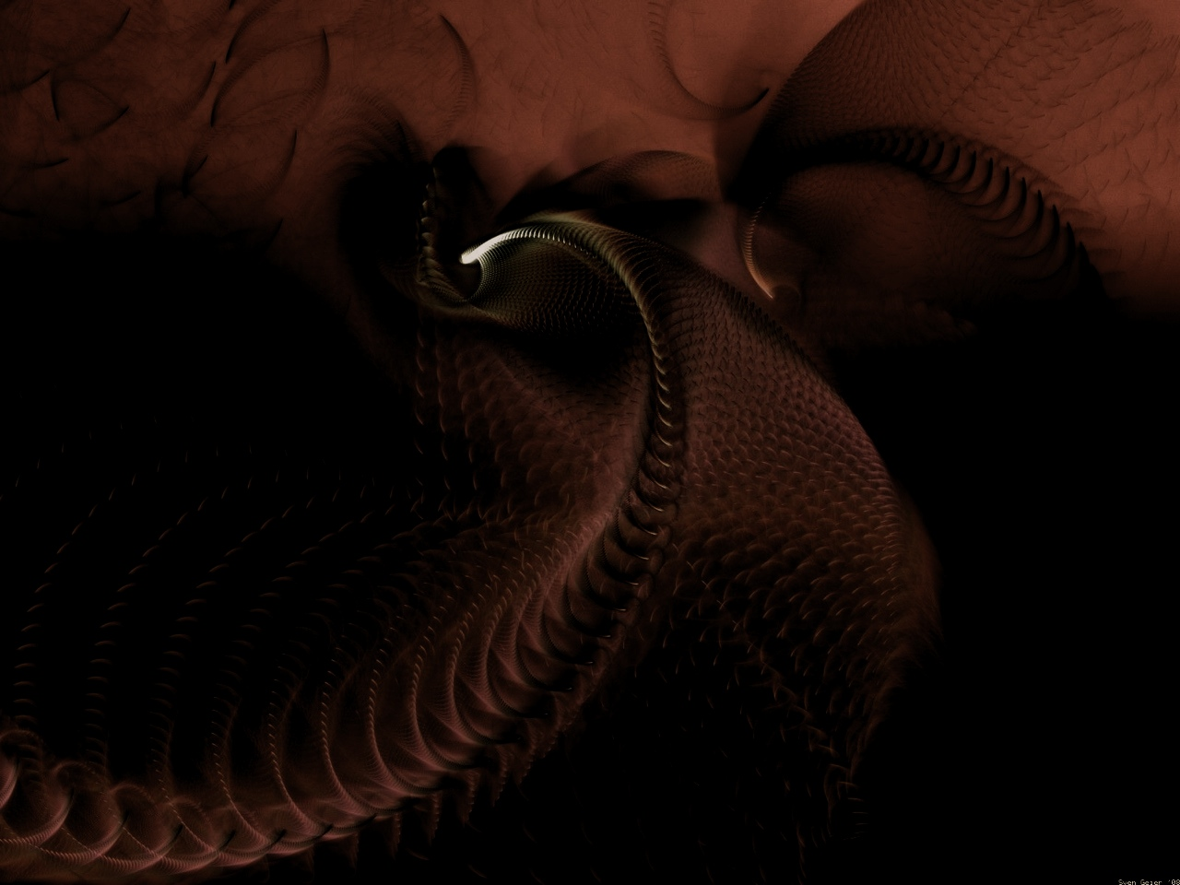
“Although the Cambrian explosion is of singular importance to our understanding of the history of life, it continues to defy explanation.”
—Kevin Peterson
evolutionary biologist

Slide 36
“The Cambrian strata of rocks, vintage about 600 my, are the oldest ones in which we find most of the major invertebrate groups. And we find many of them …
—Richard Dawkins
evolutionary biologist

Slide 37
… already in an advanced state of evolution, the very first time they appear. It is as though they were just planted there, without any evolutionary history.”
—Richard Dawkins
The Blind Watchmaker, p.229

Slide 38
“The Cambrian ‘explosion’ of body plans is perhaps the single most striking feature of the metazoan fossil record. The rapidity with which phyla and classes …
—Gregory Wray
evolutionary biologist

Slide 39
… appeared during the early Paleozoic coupled with much lower rates of appearance for higher taxa since, poses an outstanding problem for macroevolution.”
—Gregory Wray
American Zoologist 32, p. 131

Slide 40
“Elucidating the materialistic basis of the Cambrian explosian has become more elusive, not less, the more we know about the event itself.”
—Kevin Peterson et al
BioEssays 31 (2009): 737

