Slide 1
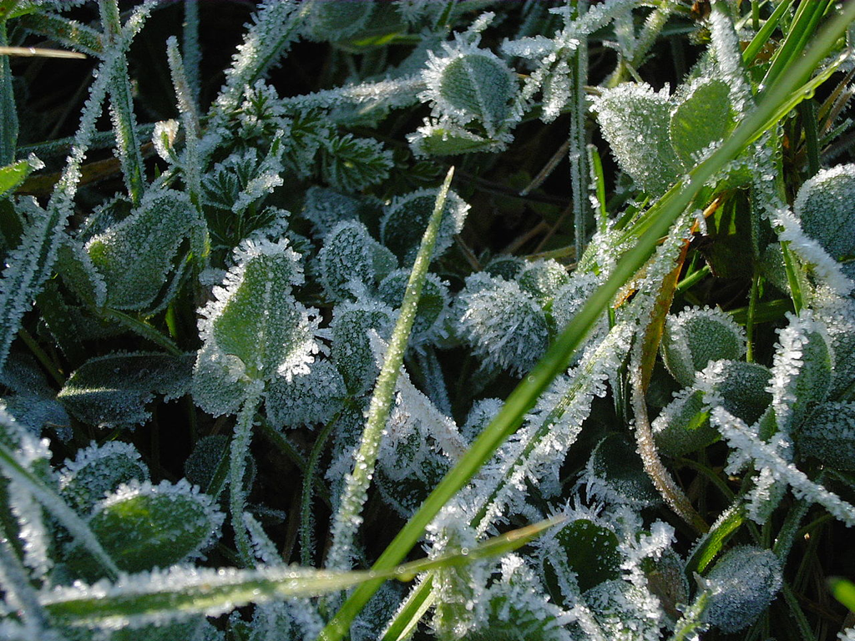
Notes:
Frost will form on a solid surface if the surface is chilled below the dew point of the surrounding air and the surface itself is colder than freezing.

Slide 2
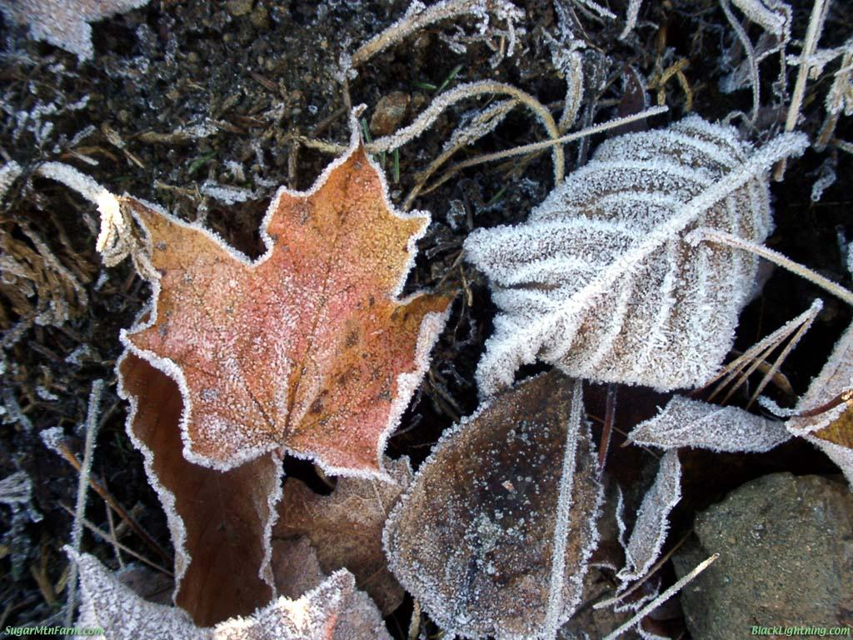
Notes:
Frost can form when there are not the clouds or the cold temperatures for snow to form and fall.

Slide 3
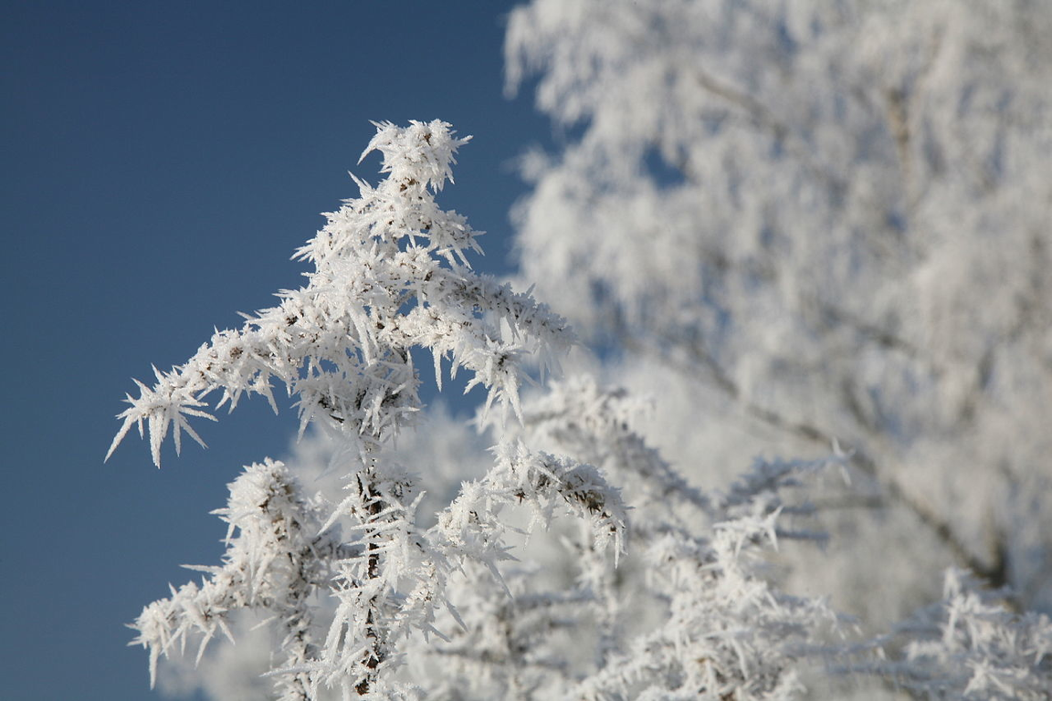
Notes:
hoar frost (radiation frost)
white ice crystals loosely deposited on the ground and on exposed objects
formed when heat is lost into the open sky causing objects to become colder than the surrounding air
can form when the air temperature is well above freezing

Slide 4
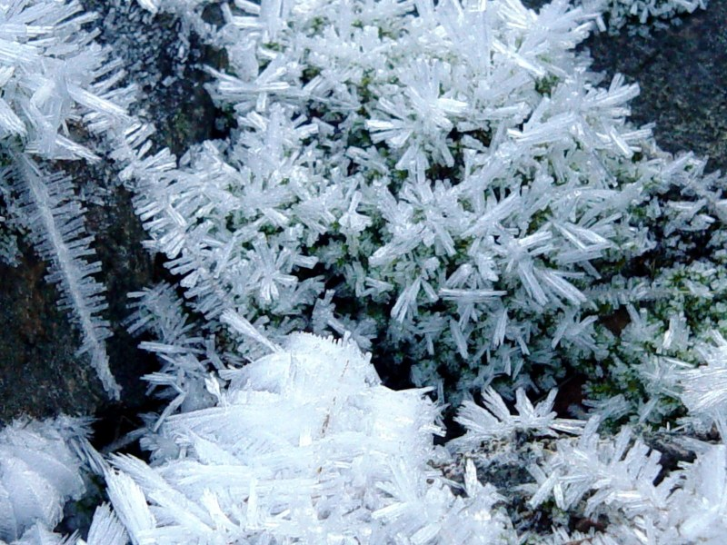
Notes:
hoar frost

Slide 5
Notes:
Hoar frost

Slide 6
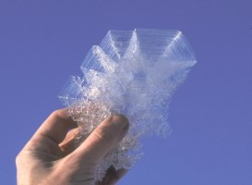
Notes:
Hoar frost crystal

Slide 7
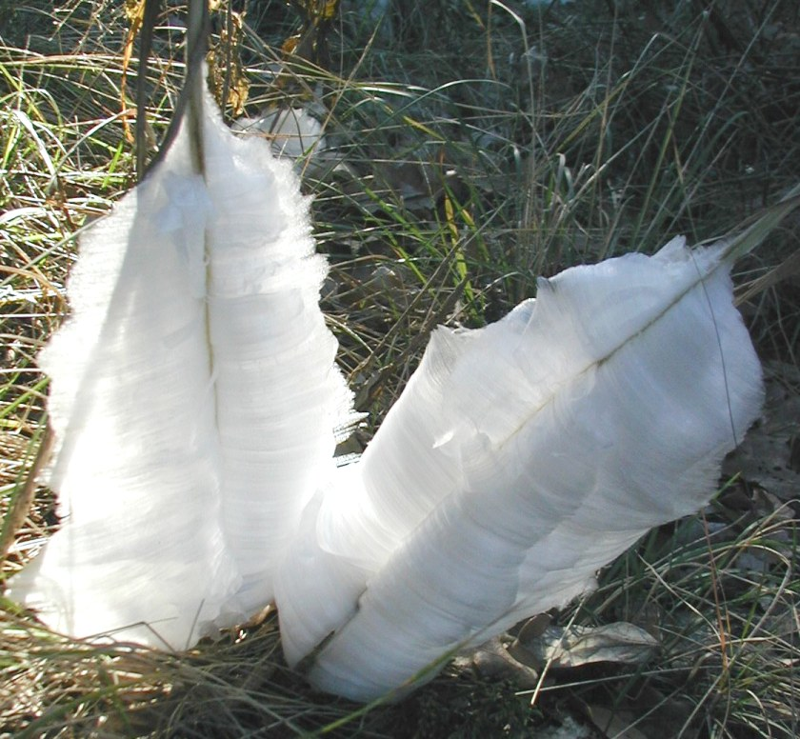
Notes:
frost flower
The bigger the frost flowers the longer they take to melt.

Slide 8
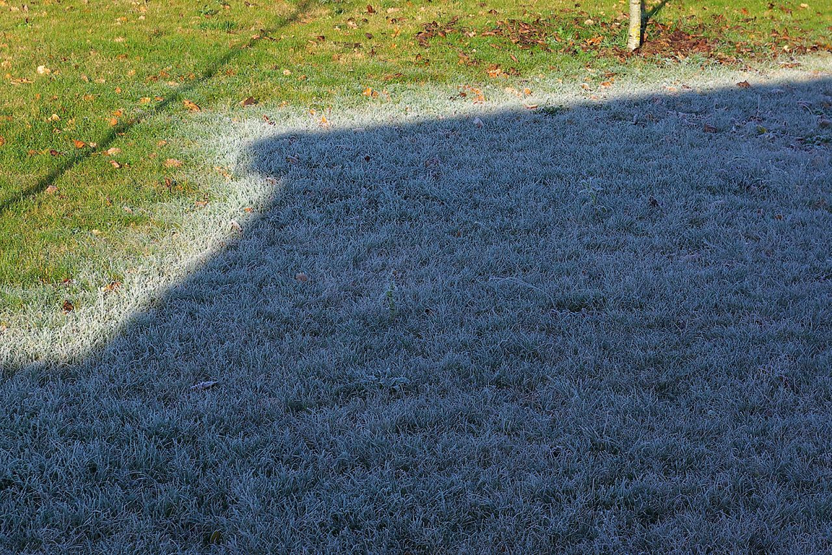
Notes:
hoar frost melting on grass

Slide 9
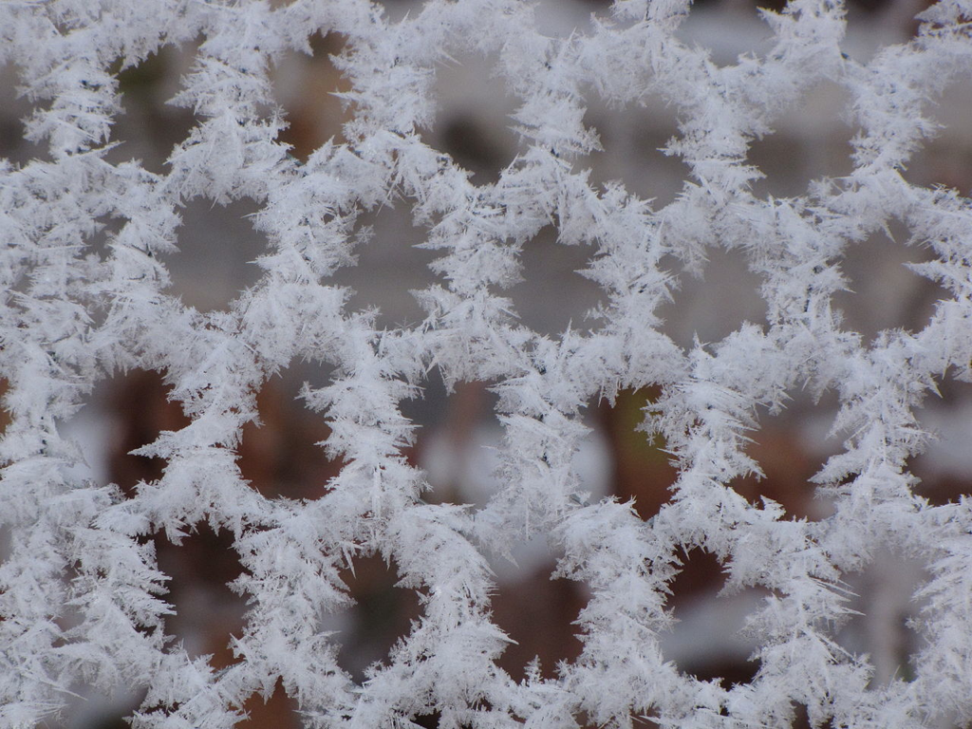
Notes:
hoar frost on fence

Slide 10
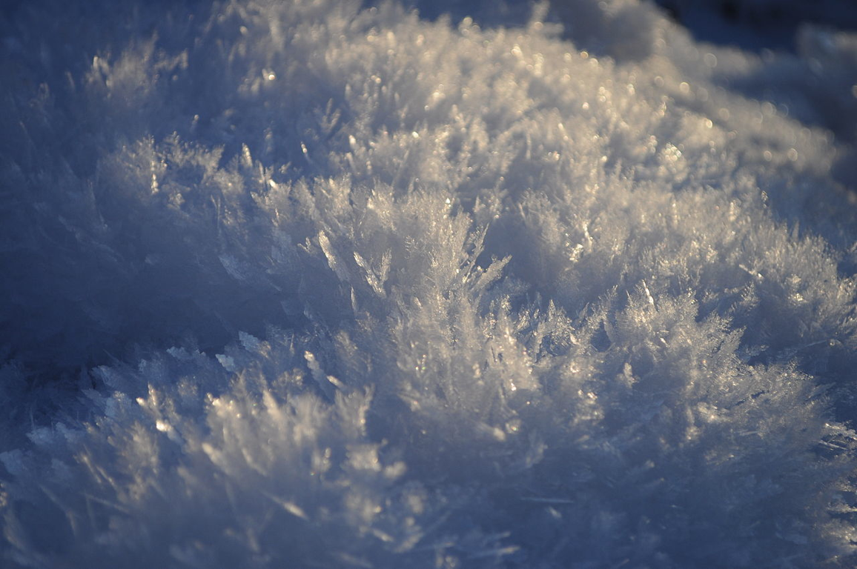
Notes:
surface frost

Slide 11
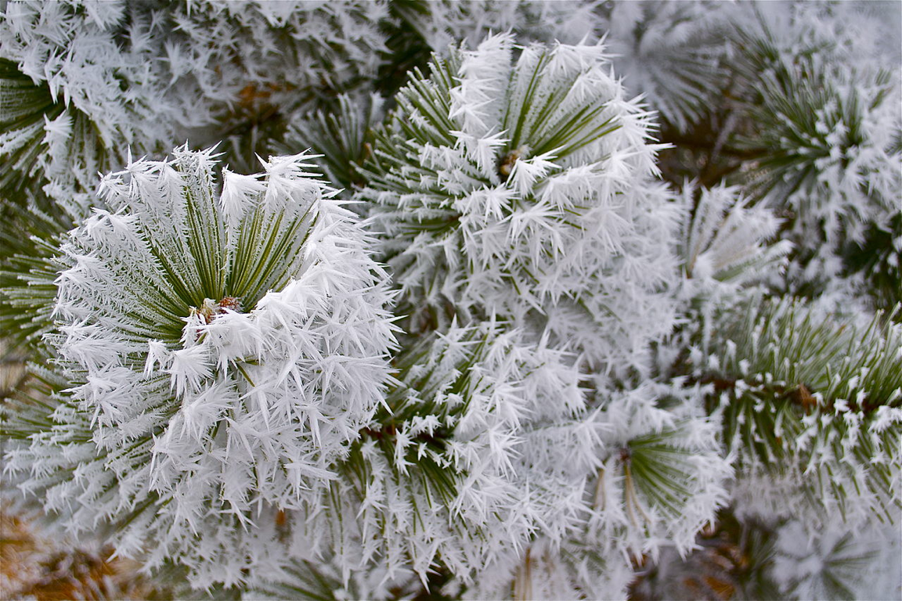
Notes:
air hoar; advection frost; wind frost
tiny ice spikes that form when a cold wind blows over the branches of trees, wires, poles, etc.

Slide 12
Notes:
rime frost
deposits quickly under windy conditions where there is heavily saturated air
has an icy solid appearance and takes a long time to melt

Slide 13
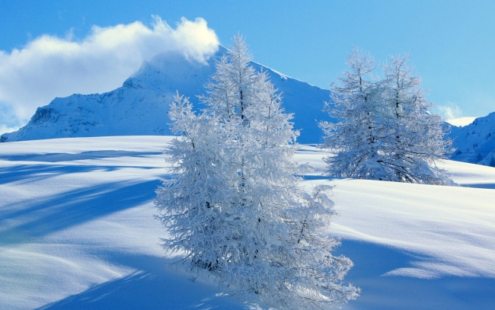
Notes:
air hoar (on tree branches) and surface hoar
Surface hoar can cause avalanches when surface hoar forms on snowy slopes.

