Slide 1
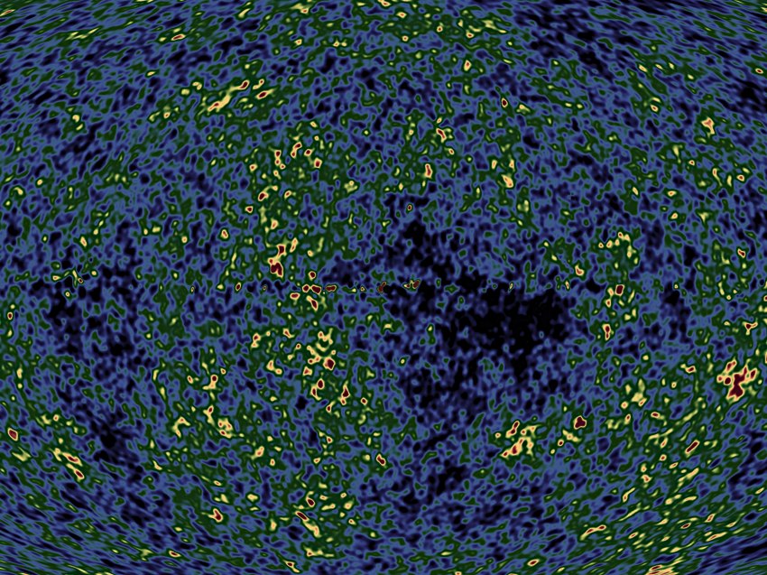
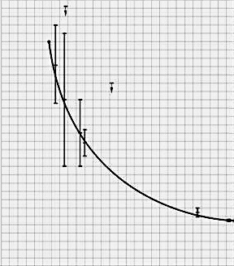
15
10
CMB temperature (°K)
5
0
0 2 4 6 8 10 12 13.8
billions of years after creation
S. Muller et al, A&A 551 (2013), id. A109
NASA
Notes:
present temperature = 2.72548 ± 0.00057 °K, Fixsen, ApJ 707 (2009), 916
Actual temperature measurements fit the curve.
Let’s look at the physical feature most responsible for cosmic expansion and cooling.

Slide 2
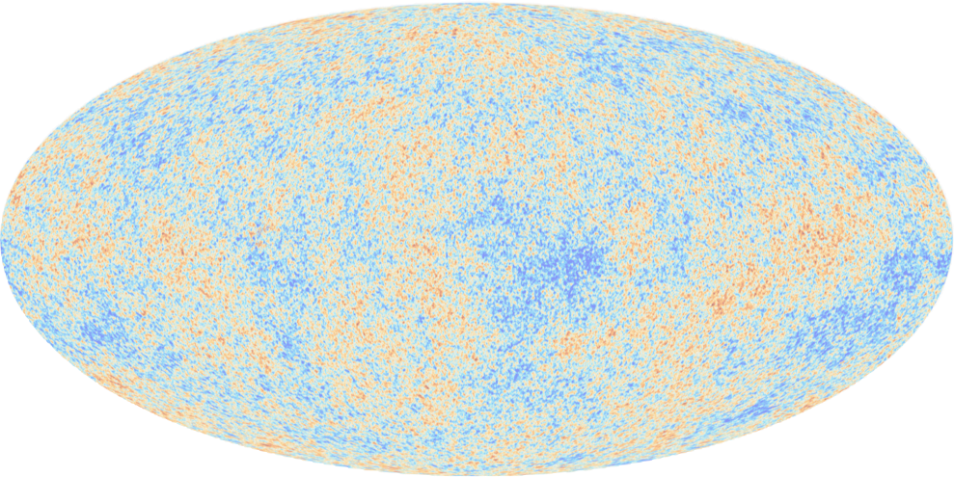
Unique Time to Observe
If we’re created earlier, creation light lacks time to reach us.
If we’re created later, dark energy expands the universe at greater than light’s velocity.
NASA

Slide 3
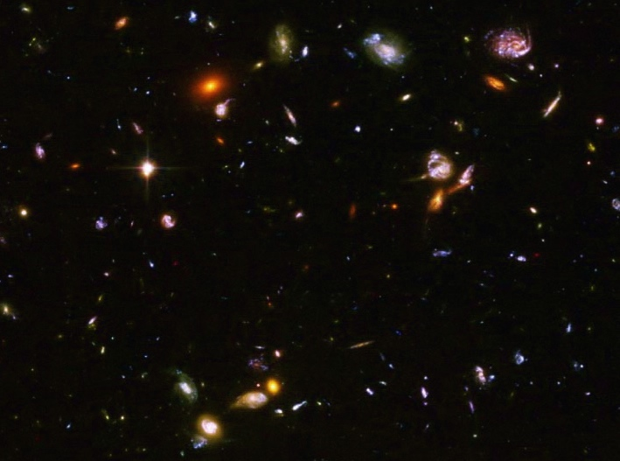
Why so old?
Only at 13.8 billion years after the cosmic creation event can humans observe all of cosmic history and directly witness the cosmic creation event.
NASA/Hubble Heritage Team STScI/AURA
Notes:
Our ability to directly witness the cosmic creation event gives us the most rigorous scientific proof for a transcendent Creator.
The universe must also be extremely dark.

Slide 4
1990

Slide 5
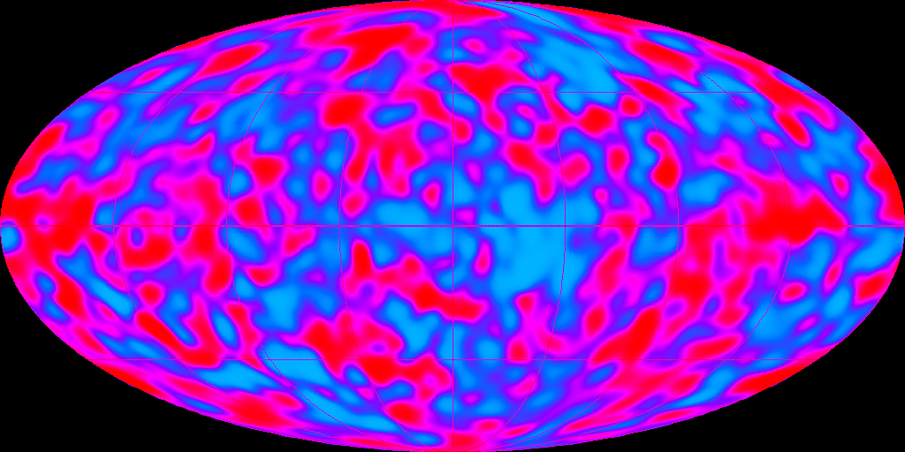
1992
Notes:
COBE
credit: NASA

Slide 6
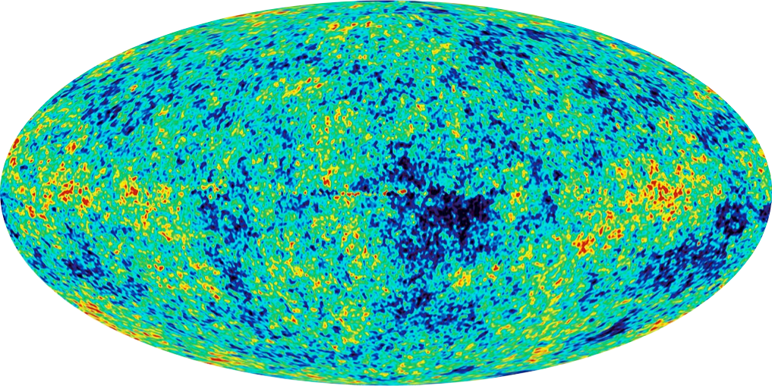
2003

Slide 7
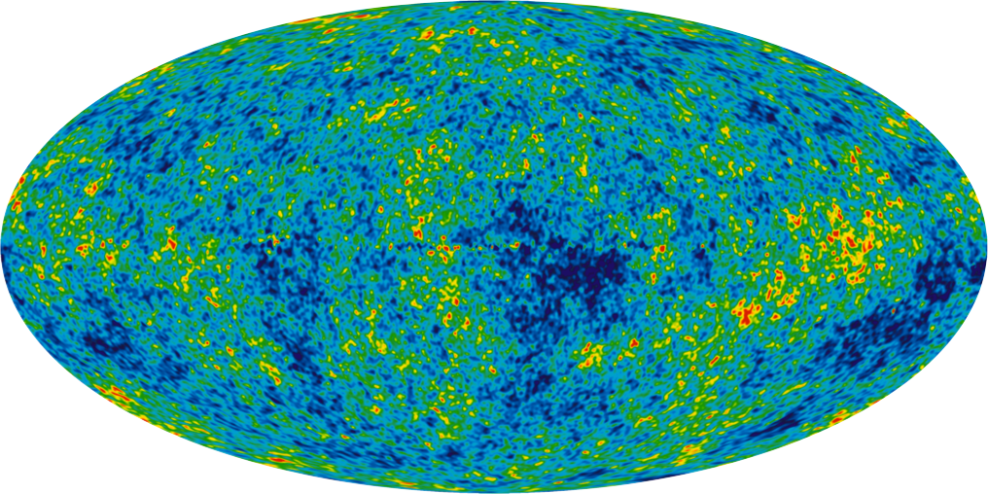
December 2012
Notes:
9-year WMAP
credit: NASA

Slide 8
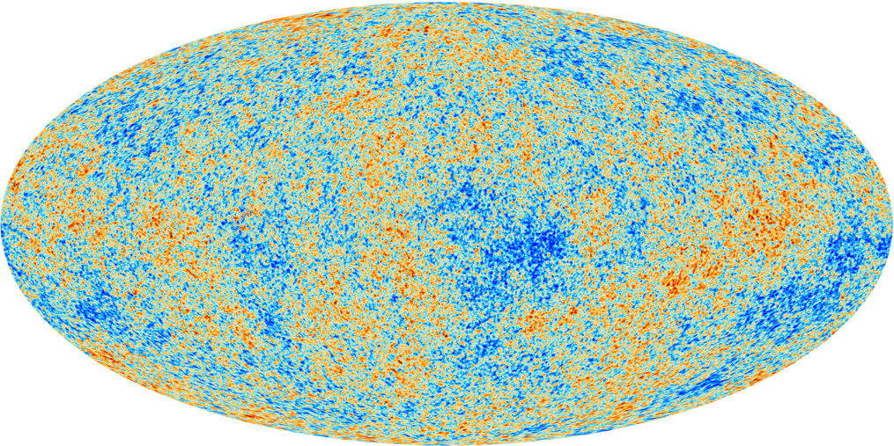
March 2013
Notes:
all sky Cosmic Microwave Background map
credit: ESA, Planck HFI & LFI Consortia

Slide 9
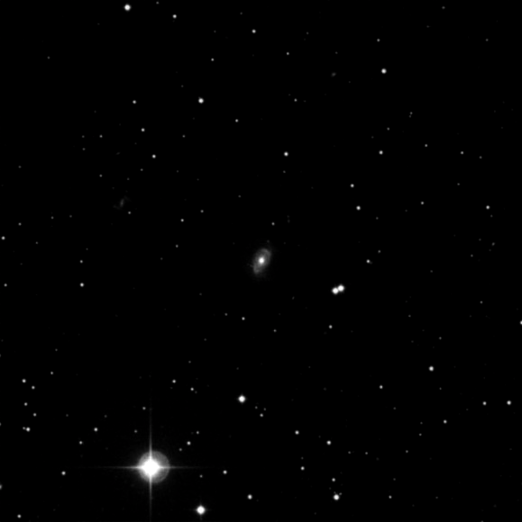
Temporal Tests
<4 x 10⁻¹⁷ (lab)
<4 x 10⁻²⁰ (future lab)
<1 x 10⁻¹⁶ (quasar)
Spatial Test
<1 x 10⁻¹ (Planck)

Slide 10
Fine Structure Constant
coupling constant characterizing the strength of electromagnetic interaction
= e²cµo/2h, where e is the electron charge, µo the magnetic constant or the permeability of free space, h is Planck’s constant.

Slide 11
Confirmed Temporal Tests
fine structure constant
electron-to-proton mass
gravitational constant
8 x 10⁻¹³ per year

Slide 12
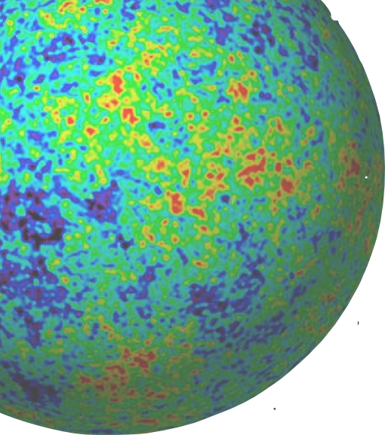
Dark Energy
NASA//WMAP
Notes:
72% of the universe’s stuff is dark energy.
It is the dominant factor governing cosmic expansion.
Cosmic expansion rates determine what kinds of stars and planets will form and when.
Here is the most spectacular evidence for supernatural design.

Slide 13
Dark Energy
Fine-tuning exceeds best human design success (gravity wave telescopes) by 10⁹⁷ times.
NASA//WMAP

Slide 14
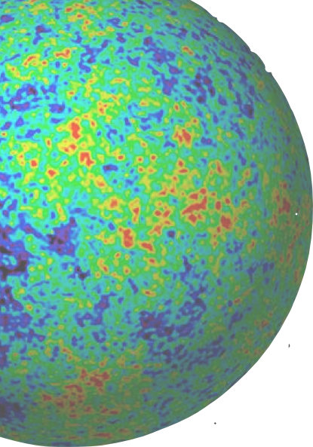
Dark Energy Quotes
“Arranging the cosmos as we think it is arranged,” say the team, “would have required a miracle.”
- Dyson, Kleban, & Susskind
quoted by Phillip Ball, NatureNews 8/13/02
NASA//WMAP

Slide 15
Dark Energy Quotes
“An unknown agent [external to space and time] intervened in the evolution [of the cosmos] for reasons of its own.”
- Dyson, Kleban, & Susskind
quoted by Phillip Ball, NatureNews 8/13/02
NASA//WMAP

Slide 16
Dark Energy Quotes
“Perhaps the only reasonable conclusion is that we do not live in a world with a true cosmological constant.”
- Dyson, Kleban, & Susskind
Journal of High Energy Physics 10 (2002): 011
NASA//WMAP

