Slide 1
In the
Beginning
God created…

Slide 2
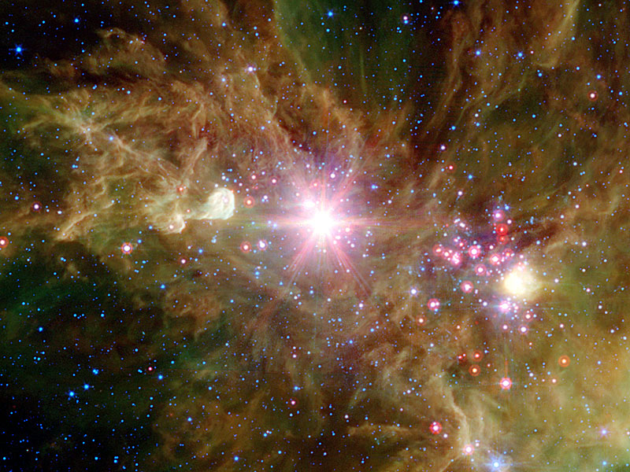
the heavens

Slide 3
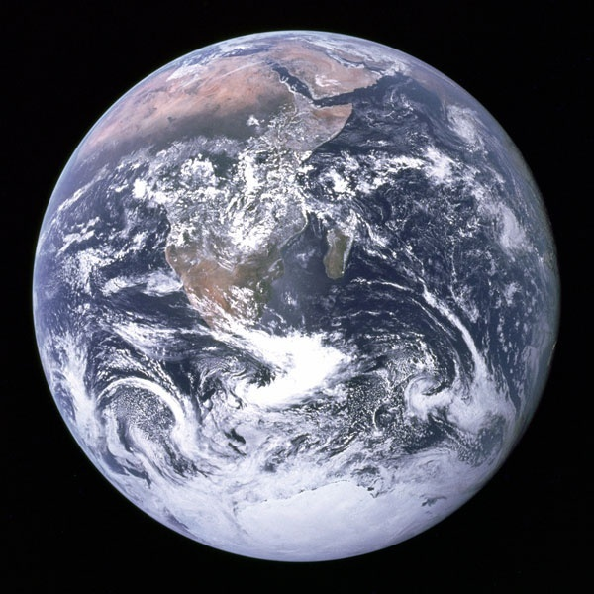
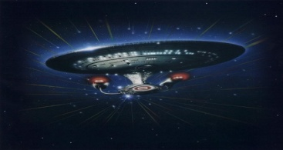
…and the Earth
Credit: Apollo 17 Crew, NASA

Slide 4
PRESENTATION IS AS FOLLOWS:
Introduction:
The Big Bang?
The Bible and Big Bang
Multiverse?

Slide 5
Main Presentation:
The Designed Universe
Universe’s Fine Tuning = Design:
Initial Factors
The Atom
Galaxies
The Sun
Solar System - Planets
Earth-Moon
Opinions of Astronomers/Physicists

Slide 6
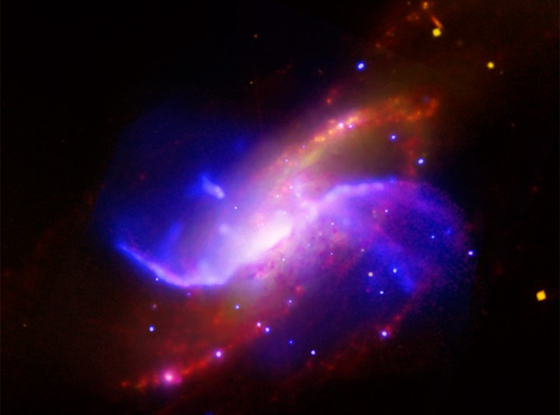
THE BIBLE & THE BIG BANG:
HOW DO THEY COMPARE?
ARMS OF NGC 4258 GALAXY: Credit-X-Ray, Yuxuan Yang (UMCP) et al, NASA, CXC, Optical-DSS, IR-NASA, JPL-Caltech & Radio NRAQ, AUI, NSF

Slide 7
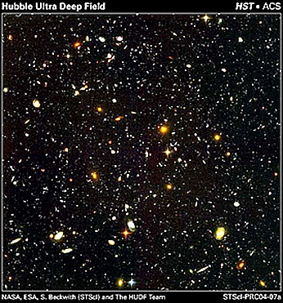
BIG BANG DEFINITION
“A precisely designed creation & expansion (not an explosion!) of space, time, energy, and matter (STEM) under God’s direction & control”
(evidence to be provided)
Therefore, it is not a random and self-evolving process.
HUBBLE ULTRA DEEP FIELD: NASA, ESA, S. Beckwith (STScI) & the HUDF Team

Slide 8
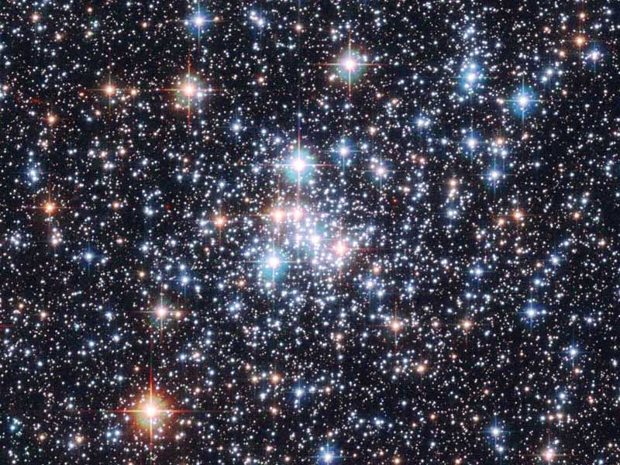
STAR CLUDSTER NGC 290: Credit – ESA, NASA; Acknowledgement – E. Olzjewski (U. of Arizona), NST

Slide 9
BIG BANG BASIC #1
The universe (all space, time, energy, and matter) had a beginning!
Therefore, the universe had to have a pre-existing “causing agent” that brought the universe into being.

Slide 10
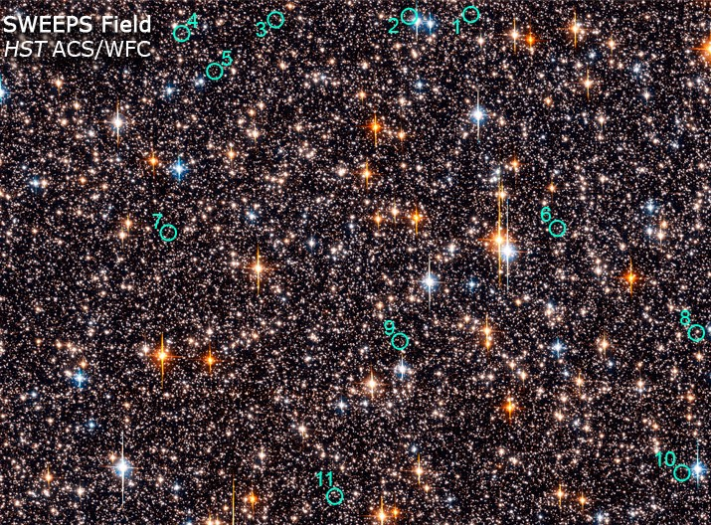
THE HUBBLE SWEEP SEARCHING FOR OTHER PLANETS: Credit – NASA, ESA, K. Sahu (STScI) & the SWEEPS Science Team

Slide 11
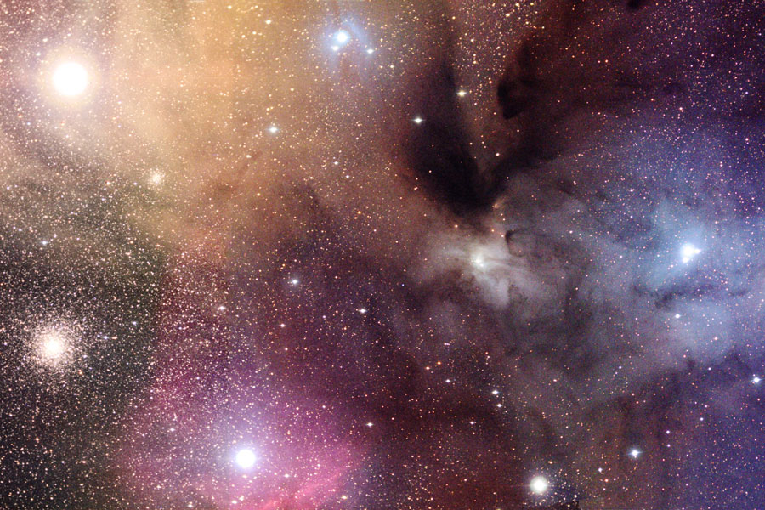
BIG BANG BASIC #1
Universe’s beginning supported by:
Einstein’s General Theory of
Relativity (parts of it proven to a
99.999999999999999%
certainty!!!)
CLOUDS OF RHO OPHIUCHI - Credit – Adam Block, KPNO Visitor Program, NOAO, AURA, NSF

Slide 12
BIG BANG BASIC #1
Universe’s beginning supported by:
2nd Law of Thermodynamics –
“everything wears out.” If universe was infinitely old, it would have “died” an infinitely long time ago.
CLOUDS OF RHO OPHIUCHI - Credit – Adam Block, KPNO Visitor Program, NOAO, AURA, NSF

Slide 13
BIG BANG BASIC #1
Beginning of the universe
supported by (continued):
Numerous scientific observations and
experiments
CLOUDS OF RHO OPHIUCHI - Credit – Adam Block, KPNO Visitor Program, NOAO, AURA, NSF

Slide 14
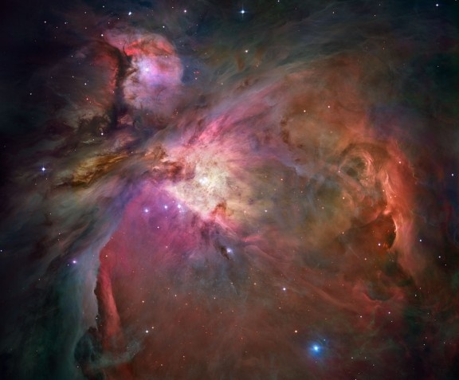
BIG BANG BASIC #1
The majority of scientists in the hard sciences are now theists (believe in a creator God)
ORION NEBULA - Credit – NASA, ESA, M. Robberto (STScI, ESA), The Hubble Space Telescope Orion Treasury project Team

Slide 15
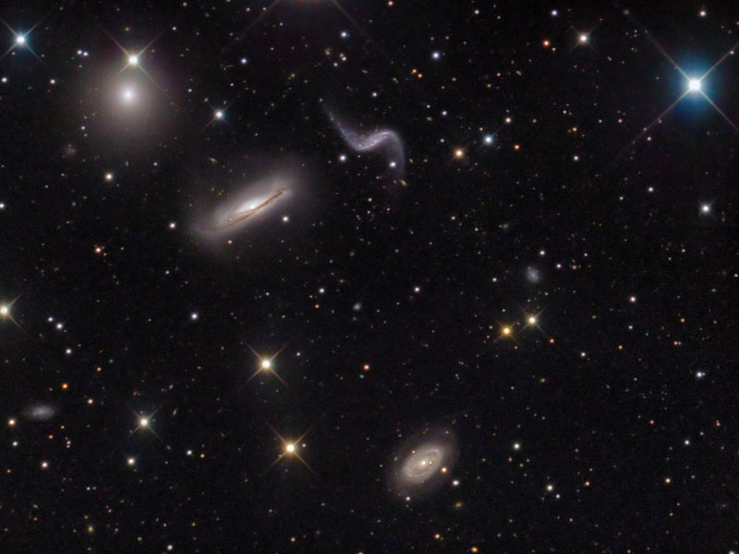
BIG BANG BASIC #2
The Universe has been expanding
since its creation & will continue to
expand
Past expansion proven by
photographic observations
Future expansion - not enough
matter to stop it & is speeding up

Slide 16
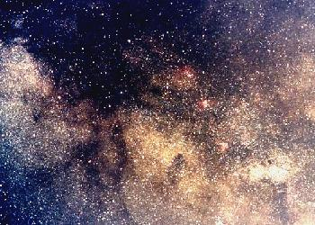
BIG BANG BASIC #3
The Universe is wearing out, growing old, and it will die
“Die” = heat death - increasing
entrophy, resulting in no more
usable energy & death of all life
2nd Law of Thermodynamics
(defined earlier) requires the
Universe’s death.
CONSTELLATION SAGISTARIUS

Slide 17
BIBLE BASICS ON COSMOLOGY
What does the Bible have to say regarding the points just covered under the Big Bang?

Slide 18
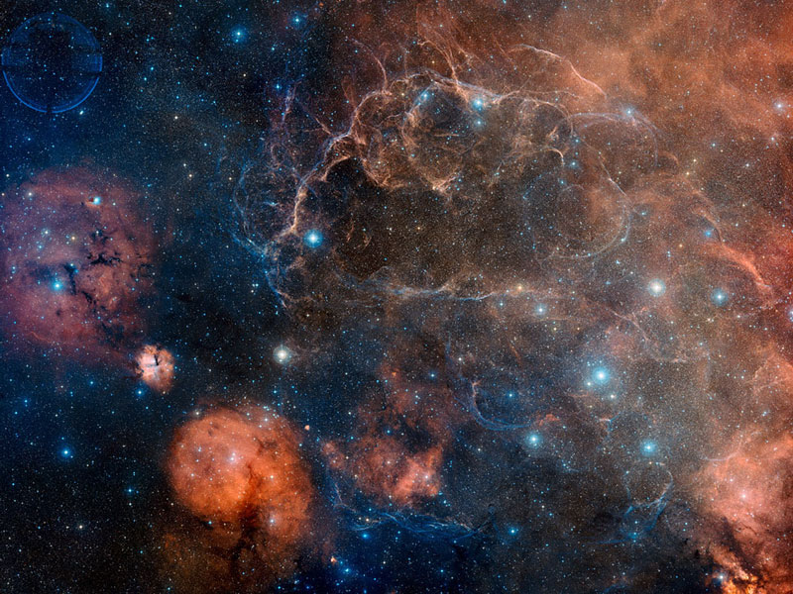
BIBLE BASIC #1
The universe (all space, time, energy and matter) had a beginning!
God, Who has always existed, is the “causing agent” Who created the universe
BIBLE BASIC #1
VELA SUPERNOVA REMNANT: Credit-Digitized Sky Survey, ESA, ESO, NASA, FITS Liberator; Color Composite-David De Martin (Skyfactory)

Slide 19
GENESIS 1:1 - In the beginning, God created (“bara”) the heavens (“hashamayin we ha `erets”) and the earth…
“Bara” means to create something new, something that did not exist before. “Hashamayin we ha `erets” means everthing…all space, time, energy, and matter.

Slide 20
Gen. 2:3, 2:4; Psalm 148:5; Isaiah 40:26, 42:5 & 45:18
In each of these verses God is said to have created (“bara”) the entirety of the heavens. Since they were created, they had a beginning.

Slide 21
The Bible teaches “time” had a beginning!
II Timothy 1:9 – “…This grace was given us in Christ Jesus before the beginning of time,…”

Slide 22
Titus 1:2 – “…a faith and knowledge resting on the hope of eternal life, which God, who does not lie, promised before the beginning of time,…”

Slide 23
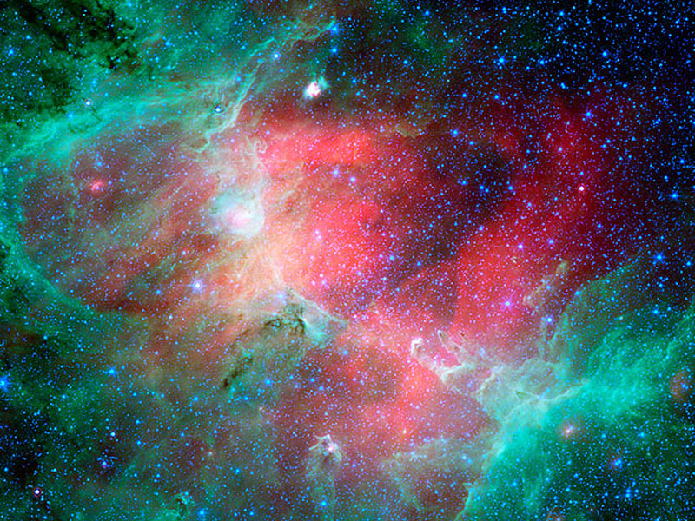
BIBLE BASIC #2
The universe has been expanding since its creation and is continuing to expand
EAGLE NEBULA IN INFRARED: Credit-NASA, JPL-Caltech, N. Flagey (IAS, SSC) & A. Noriega-Crespo (SSC, Caltech)

Slide 24
The next five verses state
that God stretched out the heavens, past tense, a completed action,
using the Qal perfect form

Slide 25
Is. 45:12 – It is I who made the earth and created mankind upon it. My own hands stretched out the heavens; I marshaled their starry hosts.

Slide 26
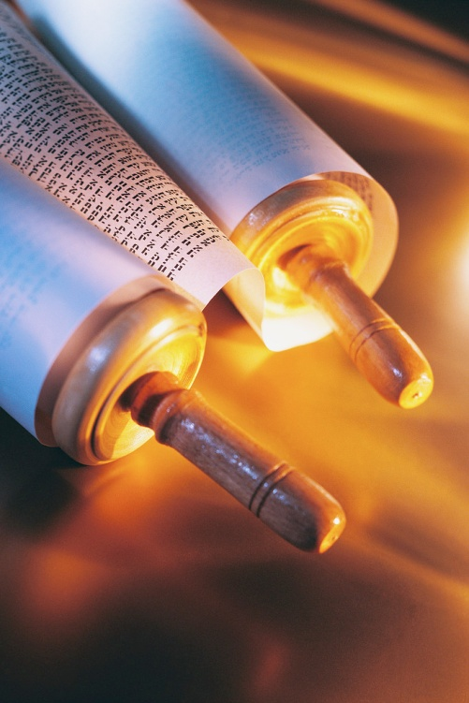
Isaiah 48:13 – My own hand laid the foundations of the earth, and my right hand spread out the heavens.
Isa 44:24 - I am the LORD, who has made all things, who alone stretched out the heavens,…

Slide 27
Isa 51:13 - that you forget the LORD your Maker, who stretched out the heavens…
Jeremiah 51:15 – He made the earth by his power; he founded the world by his wisdom and stretched out the heavens by his understanding.

Slide 28
The next four verses support Bible Basic #2 in saying that God is currently stretching out (present tense) the heavens by using the “Qal Active participate” form of the Hebrew verb “natah,” which implies ongoing stretching.

Slide 29
Job 9:8 – He alone stretches out the heavens…
Ps. 104:2 - …he stretches out the heavens like a tent

Slide 30
Is. 40:22 – …He stretches out the heavens like a canopy…
Zechariah 12:1 - …The Lord, who stretches out the heavens,…

Slide 31
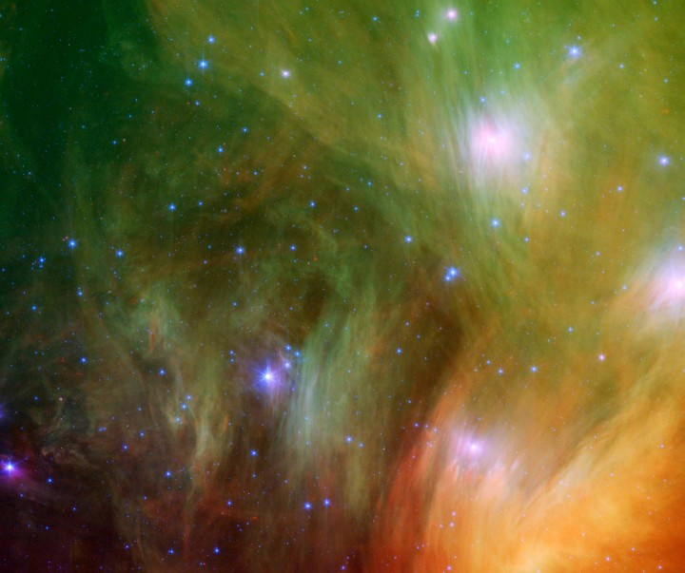
BIBLE BASIC #3
The universe is growing old, wearing out, and it will die.
SEVEN DUSTY SISTERS: Credit-NASA, JPL-Caltech, J. Stauffer (SSC, Caltech)

Slide 32
Verses in Support of Bible Basic #3:
Psalm 102:26 – “…They [the heavens] will perish, but you [God] remain; they will all wear out like a garment…”

Slide 33
Romans 8:19-21 – “For the creation was subjected to frustration,…that the creation itself will be liberated from its bondage to decay…”

Slide 34
SUMMARY OF BIBLE & BIG BANG
The Bible | The Big Bang | Conclusion
The universe (all space, time, energy & matter) had a beginning | The universe (all space, time, energy & matter) had a beginning | Agreement
A pre-existing agent brought the universe into being – this is God | Conclusion: a pre-existing agent had to bring the universe into being | Agreement
The universe was and is expanding | The universe was and is expanding | Agreement
The universe is growing old & will die | The universe is growing old & will die | Agreement

Slide 35
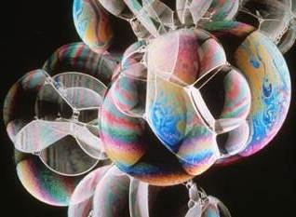
What do bubbles
have to do with
the universe?
Photo Courtesy of Lawrence Berkeley National Laboratory

Slide 36
MULTIVERSE?
Some do not like the Big Bang’s
singular universe that has a
beginning and therefore requires
a Creator/Beginner
They also do not like the Big Bang
universe that shows fine tuning and
design, and therefore, requires a
Designer.

Slide 37
MULTIVERSE?
Therefore, these few people have
come up with an idea to try to get
around requiring a Creator/Designer.
This idea is not because of any
evidence, but originates out of a
philosophical/spiritual bias against
a Creator/Designer.

Slide 38
MULTIVERSE?
They ask “What if there are an infinite no. of universes being produced (“multiverse”) by something like a cosmic bubble machine or generator (each universe is a “bubble”), over an infinite amount of time and it is just that this universe happens to be the lucky one to get everything right?

Slide 39
MULTIVERSE?
Several problems with such an idea:
There is zero evidence for it
The space-time theorem of the
Theory of Relativity prohibits
experiencing anything outside
our universe

Slide 40
MULTIVERSE?
Therefore, such an idea is not
testable science/never can be.
Consequently, it is actually an
appeal to metaphysics (the
supernatural), something outside
our material universe!

Slide 41
MULTIVERSE?
ANOTHER DESCRIPTION
FOR THIS IS:
BLIND FAITH -
a belief in something when there is either no evidence for it or
in spite of any evidence

Slide 42
MULTIVERSE?
More importantly, it contradicts
the 2nd law of thermodynamics,
which says everything must
“wear out.” Therefore, nothing
can be infinitely old.

Slide 43
MULTIVERSE?
Henceforth, cannot have an
infinitely long-lived “generator”
producing an infinite no. of
universes. Therefore, it must
have a beginning, too.

Slide 44
MULTIVERSE?
As a result, it begs the obvious question:
“Who designed the bubble/universe generator/machine?” since it would have to have a beginning. Any such mechanism would require a lot of design itself.

Slide 45
MULTIVERSE?
So, let us look at some hard science and not on philosophically-biased suppositions which have absolutely no supporting evidence.

Slide 46
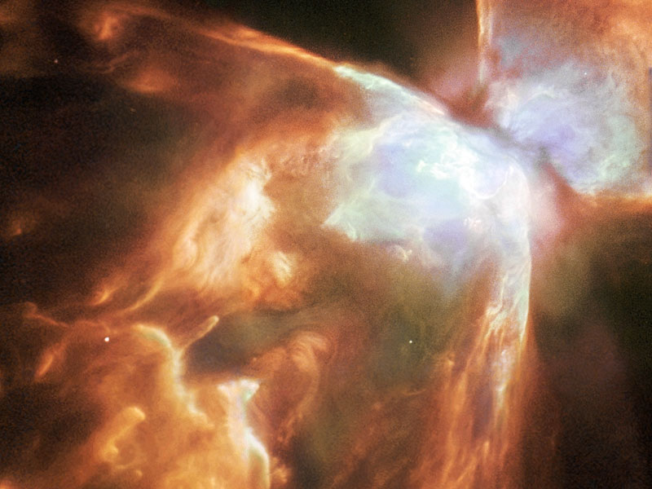
THE DESIGNED UNIVERSE
If something is “designed” it has two primary features:
Complex pattern(s)
The pattern (s) convey specific information or meaning/purpose.
NGC 6302 BUG NEBULA: Credit – A. Zijlstra (UMIST) et al, ESA, NASA

Slide 47
THE DESIGNED UNIVERSE
Is the side of a mountain “designed?”
It may have complex patterns to it, but the patterns do not convey any sort of information or purpose
NGC 6302 BUG NEBULA: Credit – A. Zijlstra (UMIST) et al, ESA, NASA

Slide 48
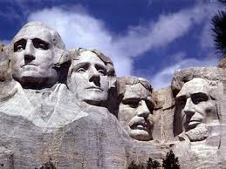
THE DESIGNED UNIVERSE
Does Mount Rushmore convey design?
Yes, as it has complex patterns that convey information – the faces of four U.S. Presidents
THE DESIGNED UNIVERSE
Does Mount Rushmore convey design?
Yes, as it has complex patterns that convey information – the faces of four U.S. Presidents
NGC 6302 BUG NEBULA: Credit – A. Zijlstra (UMIST) et al, ESA, NASA

Slide 49
THE DESIGNED UNIVERSE
Does a complex machine show design?
Yes, as the machine contains many complex patterns or parts that all work together for a given purpose.
NGC 6302 BUG NEBULA: Credit – A. Zijlstra (UMIST) et al, ESA, NASA

Slide 50
THE DESIGNED UNIVERSE
Does “I love you” written on the seashore convey design?
Yes, as the complex letter patterns convey specific information or purpose.
NGC 6302 BUG NEBULA: Credit – A. Zijlstra (UMIST) et al, ESA, NASA

Slide 51
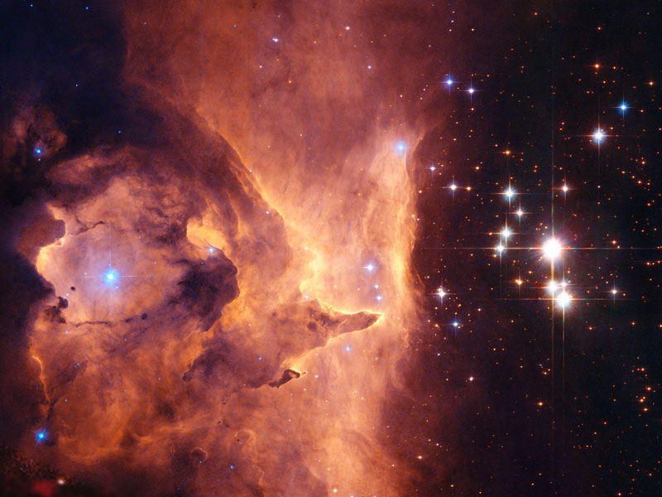
THE DESIGNED UNIVERSE
IT WILL BE SHOWN THAT
THE UNIVERSE’S INCREDIBLE COMPLEX SET OF PARAMETERS (OR “PARTS”) ARE ALL FINELY TUNED TO MAKE A HABITABLE PLANET
LIKE EARTH & LIFE POSSIBLE,
AND THEREFORE IS DESIGNED
STARS IN OPEN CUSTER PISMIS 24: Credit-NASA, ESA, J.M. Apellaniz (LAAA, Spain)

Slide 52
THE DESIGNED UNIVERSE
The hundreds of “parts” of the universe have at least one thing in common:
TO ENABLE AT LEAST ONE EARTH-LIKE PLANET TO EXIST
STARS IN OPEN CUSTER PISMIS 24: Credit-NASA, ESA, J.M. Apellaniz (LAAA, Spain)

Slide 53
THE DESIGNED UNIVERSE
Just like a machine’s many parts are put together for a given purpose(s), the universe’s many parts share a common purpose: to make possible an earth-like planet.
STARS IN OPEN CUSTER PISMIS 24: Credit-NASA, ESA, J.M. Apellaniz (LAAA, Spain)

Slide 54
THE DESIGNED UNIVERSE
AND JUST AS A MACHINE IS OBVIOUSLY DESIGNED, BY THE SAME LOGIC AND REASON THE UNIVERSE THEREFORE HAS TO BE DESIGNED.
STARS IN OPEN CUSTER PISMIS 24: Credit-NASA, ESA, J.M. Apellaniz (LAAA, Spain)

Slide 55
THE DESIGNED UNIVERSE
AND WHEN DESIGN EXISTS
THERE IS A DESIGNER.
THERE HAS NEVER BEEN AN EXCEPTION TO THIS:
DESIGN MEANS A DESIGNER
STARS IN OPEN CUSTER PISMIS 24: Credit-NASA, ESA, J.M. Apellaniz (LAAA, Spain)

Slide 56
NEVER AN EXCEPTION

Slide 57
NEVER AN EXCEPTION

Slide 58
NEVER!

Slide 59
THE DESIGNED UNIVERSE
One of the “top” atheists in Europe, Anthony Flu, an educated and erudite individual, when in his 80s, became a theist/deist due to two reasons, according to him:
“The Big Bang and The Fine Tuning of the Universe.”

Slide 60
FOLLOWING WILL BE STATISTICAL
NUMBERS WHICH ARE BEYOND
BELIEF OR COMPREHENSION
ALL THE FOLLOWING STATISTICAL
NUMBERS ARE FOUND FROM OVER
1000 SOURCES OF WRITTEN ASTRO-
PHYSICAL LITERATURE
REFER TO THE END OF THIS PRE-
SENTATION FOR MORE INFORMATION

Slide 61
AN EXPLANATION OF EXPONENTS
10²º (10 to the twentieth power), for example, is shorthand for a
“1” followed by 20 zeros. “10” is the
“base” & “20” is the “exponent”
Each increase of “1” in an exponent
means an increase of 10 times:

Slide 62
AN EXPLANATION OF EXPONENTS
So, 10²¹ is 10 times the value of 10²º
10²² is 100 times that of 10²º
10³² is 1,000,000,000,000,000 (one
trillion) times that of 10²º, and so
on.

Slide 63
10²³ is equal to the no. of grains of Sand on all the beaches of the world
10⁷⁸ is equal to the no. of
Atoms in the entire universe (interesting to note is that one drop of water contains 5 x 10²¹ atoms!!!)
10⁶⁰ is equal to the no. of
Dimes it would take to fill all the universe’s 200 billion galaxies

Slide 64
Remembering the numbers on the previous slide, it may help to think:
S – A – D stands for “sad,” as in “it is a ‘sad’ day for those who oppose intelligent design when the universe’s fine tuning is considered:
Sand – 10²³ (grains of sand on earth)
Atoms – 10⁷⁸ (atoms in universe)
Dimes - 10⁶⁰ (dimes filling all galaxies)

Slide 65
The “S-A-D” numbers will be used
to help understand just how finely tuned the universe really is

Slide 66
UNIVERSE’S FINE TUNING= DESIGN
As of the end of 2006 there are about 676 known, finely tuned parameters
that are needed to get just one planet in the entire universe that is capable of supporting simple bacteria life!!!
This calculates out to: 1 chance out of 10⁵⁵⁶ of getting such a planet in the entire universe by random chance!!!

Slide 67
UNIVERSE’S FINE TUNING= DESIGN
The next page shows some of the figures as of 2006. The various categories have some parameters that they share in common, but they have a grand total, as stated earlier, of 676.

Slide 68
UNIVERSE’S FINE TUNING= DESIGN
Again, these figures are the odds of getting just one planet capable of supporting bacteria life by random chance. These figures are NOT pertaining to the odds of getting life by random chance, which are far, far more remote.

Slide 69
Summary of No. of Fine-Tuning Parameters by General Categories
Initial (just after creation) | 6
Atomic | 15
Galaxy cluster | 99
Galaxy | 200
Star | 140
Planetary System | 137
Planet | 268
Planet’s surface | 137
Moon | 27
Others | 100

Slide 70
Summary of Fine-Tuning Parameters by General Categories
Not all the factors in each general category on the previous page will be examined…
just some of them
(we only have a few hours!)

Slide 71
FINE TUNING OF
INITIAL FACTORS
JUST AFTER CREATION
Expansion Rate of Universe
Space-Mass Density Ratio
Space-Energy Density Ratio
Ratio of Gravity to Electro-
magnetic Force

Slide 72
UNIVERSE’S FINE TUNING =DESIGN
Expansion Rate of Universe:
During the first fraction of a second after creation if the expansion rate of the universe were off by more than only 1 in 10⁵⁷ there would be no planet capable of life anywhere in the entire universe!

Slide 73
UNIVERSE’S FINE TUNING =DESIGN
Any faster of a rate would result in
only light elements (hydrogen, etc.),
& any slower there would be too
many heavy elements

Slide 74
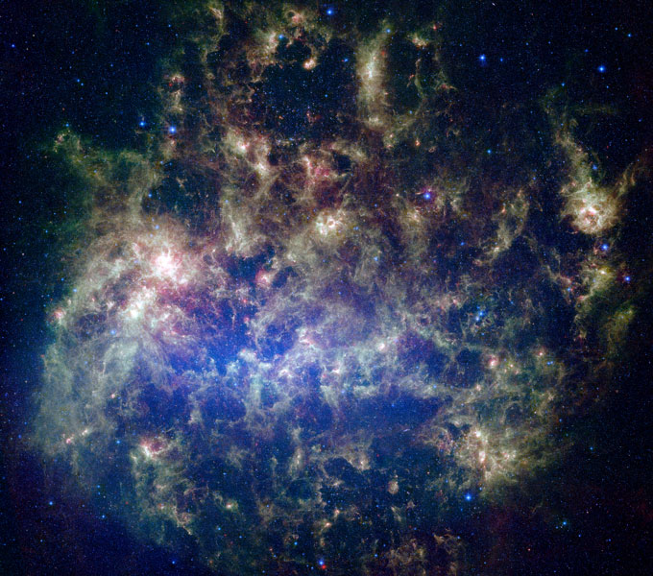
1 out 10⁵⁷ is like saying that:
Take all the grains of sand on all the beaches on earth (10²³) and multiply that by one trillion, by one trillion, by 10 billion times!!!
Mark one of the grains of sand, mix it all up…

Slide 75
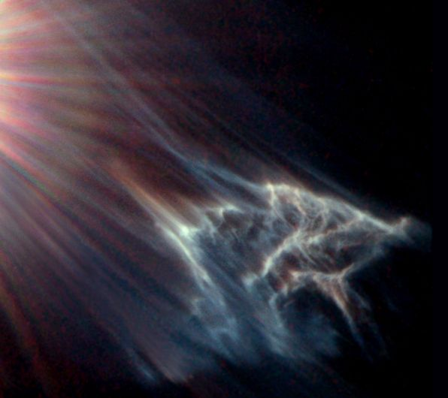
Then dive down, blindfolded, and on the first try get the
right grain of sand!!!
STARLIGHT EFFECT ON CLOUD OF GAS & DIRT: Cr-Hubble Heritage Team, George Herbig & Theodore Simon, UFA (U. of Hawaii), NASA

Slide 76
ONE MORE EXAMPLE….
1 out 10⁵⁷ is like saying:
Get in a car and drive 1,000,000,000,
000,000,000,000,000,000,000,000,
000,000,000,000,000,000,000,000
MPH
STARLIGHT EFFECT ON CLOUD OF GAS & DIRT: Cr-Hubble Heritage Team, George Herbig & Theodore Simon, UFA (U. of Hawaii), NASA

Slide 77
That is 1,000,000,000,000,000,000,
000,000,000,000,000,000,000,000,
000,000 times
around the earth
per sec.
STARLIGHT EFFECT ON CLOUD OF GAS & DIRT: Cr-Hubble Heritage Team, George Herbig & Theodore Simon, UFA (U. of Hawaii), NASA

Slide 78
If you change by 1 MPH average
you destroy all possibility of life!
STARLIGHT EFFECT ON CLOUD OF GAS & DIRT: Cr-Hubble Heritage Team, George Herbig & Theodore Simon, UFA (U. of Hawaii), NASA

Slide 79
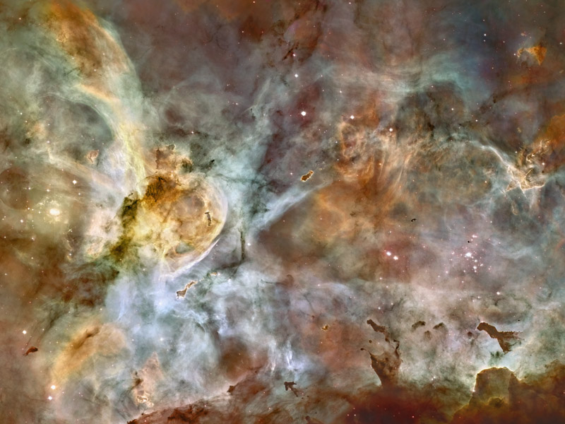
UNIVERSE’S FINE TUNING = DESIGN
Space-Matter Density Ratio:
All the universe’s matter is created
in just less than one second (10­⁴³
of a second) after the big bang event.
By that time, if the amount of matter was off by more than 1 out of 10⁶º (=1 dime!!!), no earth anywhere, anytime!
CARINA NEBULA: Credit-NASA, ESA, N. Smith (U. of Calif. At Berkeley) et al & Hubble Heritage Team (STScI, AURA)

Slide 80
UNIVERSE’S FINE TUNING = DESIGN
That alone answers the question:
“Why have all that ‘stuff’ out there for just life on this one planet!”
CARINA NEBULA: Credit-NASA, ESA, N. Smith (U. of Calif. At Berkeley) et al & Hubble Heritage Team (STScI, AURA)

Slide 81
1 out of 10⁶º is like saying:
Take all the grains of sands of all
the earth’s beaches, which total
10²³
Multiply that by more than one
trillion by one trillion by one
trillion times
CARINA NEBULA: Credit-NASA, ESA, N. Smith (U. of Calif. At Berkeley) et al & Hubble Heritage Team (STScI, AURA)

Slide 82
Mark one grain of sand in this huge pile, mix it up, then dive down blindfolded and get the right grain of sand on the first try!!!
CARINA NEGULA: Credit-NASA, ESA, N. Smith (U. of Calif. At Berkeley) et al & Hubble Heritage Team (STScI, AURA)

Slide 83
But wait!!!

Slide 84
More recent research has shown
That the mass-space density
ratio of 1 out of 10⁶º has been
“replaced” with an even more
Finely tuned parameter….

Slide 85
DARK ENERGY
Dark energy is the self-stretching
property of space that causes it to expand (about 72% of all there is)

Slide 86
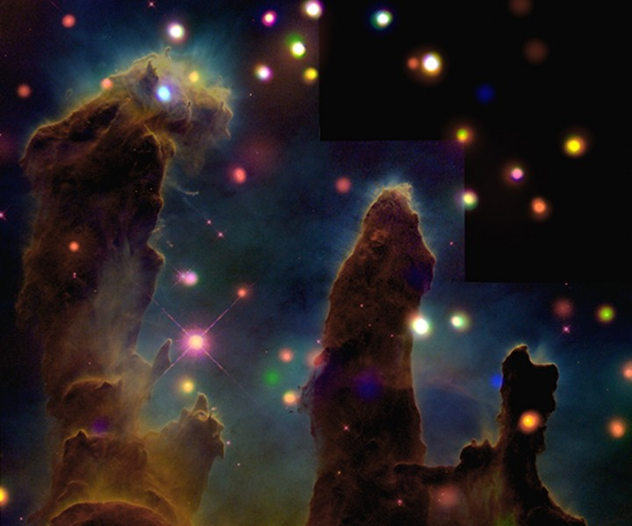
UNIVERSE’S FINE TUNING = DESIGN
Space-Energy Density Ratio:
If the ratio of dark energy to space
were off by more than 1 out of
10¹²º, there would be no planet able to support life, anywhere!
Eagle Nebula: Credit-NASA-CXC, J. Linsky (U. of Colorado), et al. Optical: NASA, ESA, STScI, J. Hester, P. Scowen (ASU)

Slide 87
1 out of 10¹²º is like saying:
Multiply our universe, which has
10⁷⁸ atoms, by one trillion by one trillion by one hundred million times…
Eagle Nebula: Credit-NASA-CXC, J. Linsky (U. of Colorado), et al. Optical: NASA, ESA, STScI, J. Hester, P. Scowen (ASU)

Slide 88
Then mark one atom, mix all this up, and dive down blindfolded & get the marked one on the first try!!!
Eagle Nebula: Credit-NASA-CXC, J. Linsky (U. of Colorado), et al. Optical: NASA, ESA, STScI, J. Hester, P. Scowen (ASU)

Slide 89
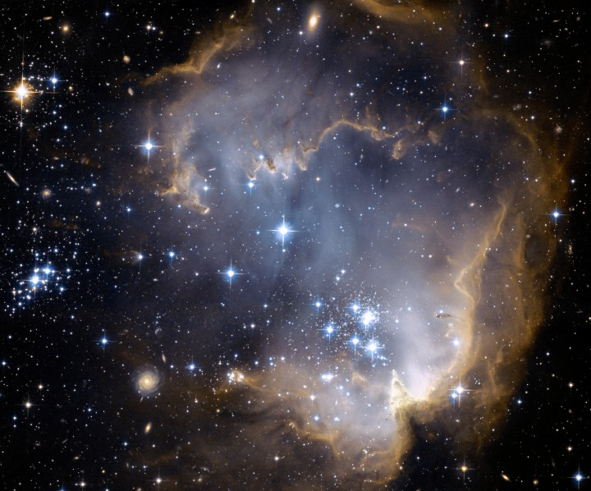
UNIVERSE’S FINE TUNING = DESIGN
Ratio of Gravity to
Electromagnetic Force:
If were different by more than 1
out of 10⁴º, there would be no life
anywhere in the Universe!!!
STAR CLUSTER NGC 602: Credit-NASA, ESA, & Hubble Heritage Team (STScI, AURA), ESA, Hubble Collaboration

Slide 90
1 out of 10⁴º is like saying:
Again, in terms of grains of sand, : it would take 10²³ grains of sand to equal all of the grains of sand on all the earth’s beaches;
Multiple all that by one trillion by 100,000 times.
STAR CLUSTER NGC 602: Credit-NASA, ESA, & Hubble Heritage Team (STScI, AURA), ESA, Hubble Collaboration

Slide 91
1 out of 10⁴º is like saying:
Remove one grain of sand and that destroys the possibility of even one planet capable of supporting life!!!
STAR CLUSTER NGC 602: Credit-NASA, ESA, & Hubble Heritage Team (STScI, AURA), ESA, Hubble Collaboration

Slide 92
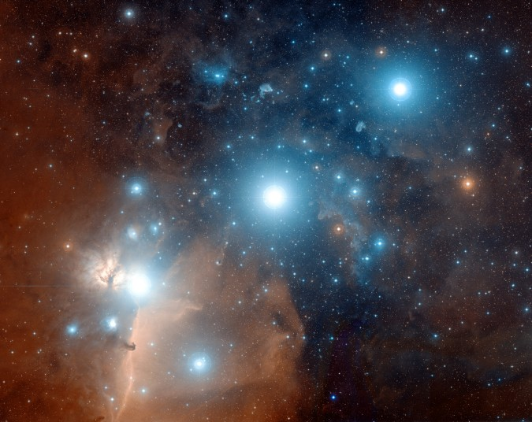
UNIVERSE’S FINE TUNING = DESIGN
So far, we have examined only the universe’s three (the mass-space density ratio replaced by the energy-space density ratio) Initially Fine Tuned parameters, which have a random chance of 1 out of 10²¹⁷ of occurring
(10⁵⁷ x 10¹²º x 10⁴º).
STARS ALMITAK, ANILAM, MINTAKA: Credit-Digitized Sky Survey, ESA, ESO, NASA, FIS Liberator; Color Composite – Davide De Martin (Skyfactory)

Slide 93
1 out of 10²¹⁷ is like saying:
Take all the atoms in the universe (i.e., 10⁷⁸) and multiple them:
by one trillion by one trillion
by one trillion by one trillion
by one trillion by one trillion
by one trillion by one trillion
by one trillion by one trillion
by one trillion by 10,000,000 times!!!
STARS ALMITAK, ANILAM, MINTAKA: Credit-Digitized Sky Survey, ESA, ESO, NASA, FIS Liberator; Color Composite – Davide De Martin (Skyfactory)

Slide 94
Mark one atom, mix all of them up and dive down blindfolded and get the marked atom on the first try!!!
(or…remove one atom and you thereby eliminate any chance of a life-supporting planet anywhere, anytime!!!)
STARS ALMITAK, ANILAM, MINTAKA: Credit-Digitized Sky Survey, ESA, ESO, NASA, FIS Liberator; Color Composite – Davide De Martin (Skyfactory)

Slide 95
Now, we only have about 670 more finely tuned parameters to go to merely get one planet that is capable of supporting life!
Again, this is not to make life, but only to make one planet in the entire Universe capable of supporting life!
STARS ALMITAK, ANILAM, MINTAKA: Credit-Digitized Sky Survey, ESA, ESO, NASA, FIS Liberator; Color Composite – Davide De Martin (Skyfactory)

