Slide 1
Paradoxes Class
David Sargent
October 21, 2012

Slide 2
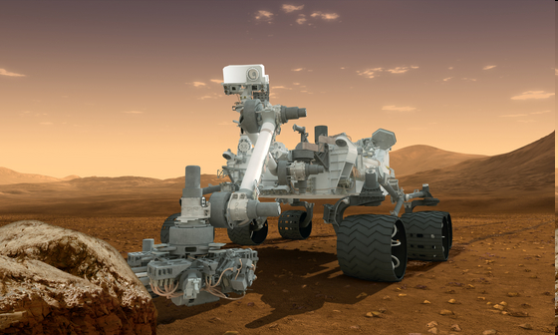
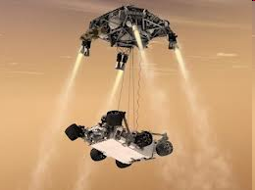
Mars Science Laboratory - MSL Curiosity Rover
Landing Aug 5, Sunday 10:30 pm
NASA coverage starts at 8:30 pm

Slide 3
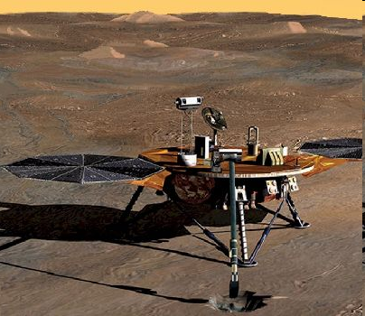
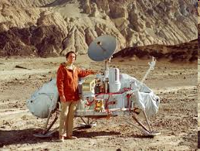
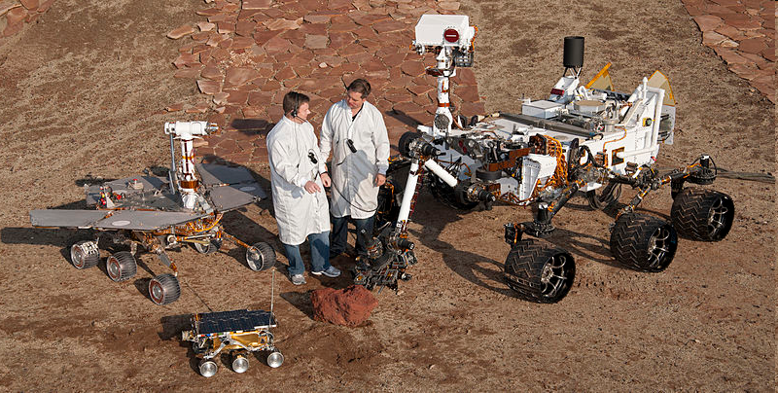
Mars Landings 1976 - 2012

Slide 4
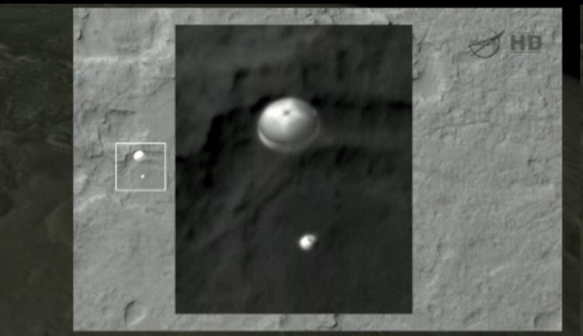
Mars rover Curiosity under its parachute as it landed on Mars on Aug. 5 Reconnaissance Orbiter Photo.

Slide 5
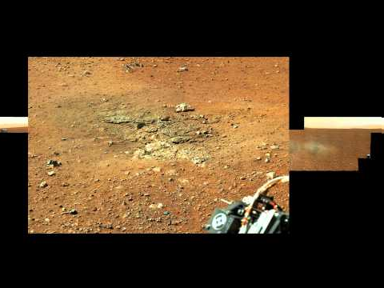
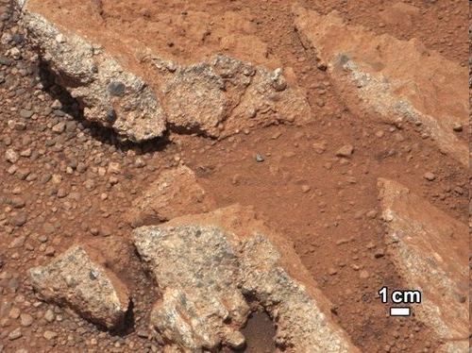
Curiosity High-Resolution Photo
.

Slide 6
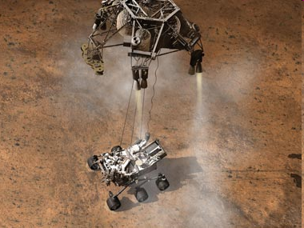
Sky Crane

Slide 7
Scientific Method
The Scientific Method came from the Christian European Renaissance from 1300 to 1600.
Christianity played a strong role in the renaissance as can be seen in its influence in the birth of modern science.
Christians awed by the grandeur of God's creative work have long striven to understand His creativity through scientific study.

Slide 8
Scientific Method
Ask a Question - Formulate a question
Do Background Research
Construct a Hypothesis – Make a Prediction
Test Your Hypothesis by Doing an Experiment – Test – Define frame of reference.
Analyze Your Data and Draw a Conclusion
Communicate Your Results

Slide 9
The Bible Asks Us To Test
1 Thessalonians 5:21
Test everything. Hold on to what is good.
Psalm 34:8
Taste and see that the Lord is good

Slide 10
Physical World Reveals God
Romans 1: 19-20
Since what may be known about God is plain to them, because God has made it plain to them. For since the creation of the world God’s invisible qualities—his eternal power and divine nature—have been clearly seen, being understood from what has been made, so that people are without excuse.

Slide 11
Hebrews 11:1-3
Now faith is confidence in what we hope for and assurance about what we do not see. This is what the ancients were commended for, by faith we understand that the universe was formed at God’s command, so that what is seen was not made out of what was visible.

Slide 12
Beginning of Time
Titus 1:2
…God, who does not lie, promised before the beginning of time.

Slide 13
There are 17 verses in the Bible state that God has and is expanding the size of the Universe (heavens) from its original size. 1000 BC to 518 BC
Isaiah 40:22
Ezekiel 1:22
Isaiah 42:5
Isaiah 44:24
Isaiah 45:12
Isaiah 48:13
Isaiah 51:13
Jeremiah 10:12
Jeremiah 51:15
Job 9:8
Job 26:7
Job 37:18
Psalms 18:9
Psalms 104:2
Psalms 144:5
2 Samuel 22:10
Zechariah 12:1

Slide 14
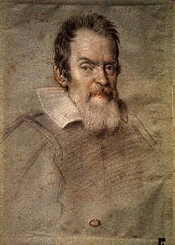
Galileo 1564 – 1642
Genuinely Roman Catholic.
He was educated in a Catholic Monastery and a Catholic University
in Italy.
Although he seriously considered the priesthood as a young man, at his father's urging he instead to study for a medical degree.

Slide 15
Galileo 1564 – 1642
Galileo defended heliocentrism, and claimed it was not contrary to Scripture. He took Augustine's position on Scripture: not to take every passage literally, particularly when the scripture in question is a book of poetry or song.

Slide 16
Galileo 1564 – 1642
He believed that the writers of the Scripture wrote from the perspective of the terrestrial world, from that vantage point the sun does rise and set.
Galileo claimed that science did not contradict Scripture.

Slide 17
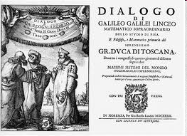
Galileo 1564 – 1642
The Roman Catholic Church is often blamed for persecuting Galileo. What is often missed is that Galileo was not always honest or ethical in his actions and communication with the Roman Catholic, especially concerning his book on the Geocentricism and Heliocentrism.
Dialogue on the Two Great World Systems. 1632

Slide 18
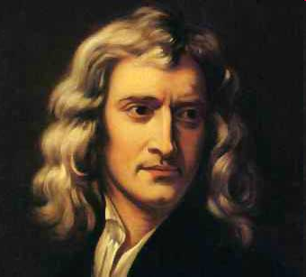
Isaac Newton 1642 – 1727
In 1661 Newton entered Trinity College in Cambridge, at the time a religious institution, as student and then as a teacher. This was his home for 35 years.
A member of the Anglican church, attend services and participated in special projects, such as paying for the distribution of Bibles among the poor, and serving on a commission to build 50 new churches in the London area.

Slide 19
Isaac Newton 1642 – 1727
Newton wrote more on religion than he did on natural science. But he never made a public declaration of his private faith.

Slide 20
Isaac Newton 1642 – 1727
Newton saw God as the master creator whose existence could not be denied in the face of the grandeur of all creation.

Slide 21
Isaac Newton 1642 – 1727
Newton’s theology influenced his scientific method, which rejected pure speculation in favor of observations and experiments. His God was not merely an impersonal First Cause. The God of the Bible who freely creates and rules the world, who speaks and acts in history. The biblical doctrine of creation was the foundation of Newton’s science.

Slide 22
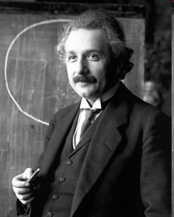
Albert Einstein 1879 1955
The Einstein family were non-observant Jews in Germany. Albert attended a Catholic elementary school from the age of five for three years.
In 1933 move to the USA.

Slide 23
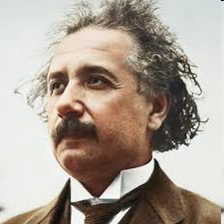
Albert Einstein
Albert Einstein’s philosophy about the supernatural is complicated, like his theories in physics. His most telling statement was, “I believe in Spinoza's God who reveals himself in the orderly harmony of what exists, not in a God who concerns himself with the fates and actions of human beings.”

Slide 24
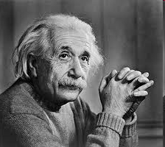
Albert Einstein
Einstein seems to have rejected traditional religious views in favor of a force that gives order to the universe. We might call Einstein a “Deist” since he believed in some organizing power but completely rejected the idea of a personal God.

Slide 25
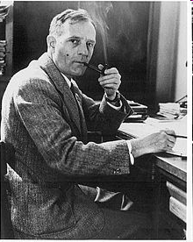
Edwin Hubble 1889 – 1953
Hubble was raised Christian in a Baptist church, the pastor was know as scholarly.
His dad was Church Trustee and mom a Sunday School teacher.

Slide 26
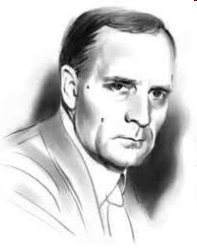
Edwin Hubble
After graduation from Oxford in England and coming home after his parents has moved, he stopped going to church.
In early letters wrote about the idea that he believed he had some sort of “destiny”.

Slide 27
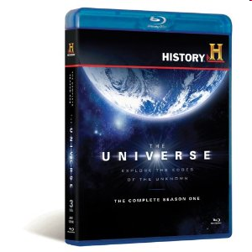
The History Channel The Universe: Beyond The Big Bang
Part 1

Slide 28
The History Channel The Universe: Beyond The Big Bang
Part 1

